Slide 1

Slides for Courses Using the Business Intelligence Guidebook
From Data Integration to Analytics
by
Rick Sherman
www.biguidebook.com

Slide 2
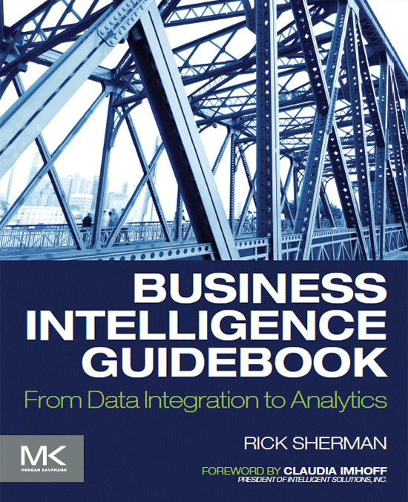
Business Intelligence Guidebook – From Data Integration to Analytics
www.biguidebook.com
November 2014
Imprint: Morgan Kaufmann
Print Book ISBN : 9780124114616
eBook ISBN : 9780124115286

Slide 3
Chapter 1 The Business Demand for Data, Information and Analytics

Slide 4

Too much information
f01-01

Slide 5

No water to drink, no information to consume
f01-02

Slide 6
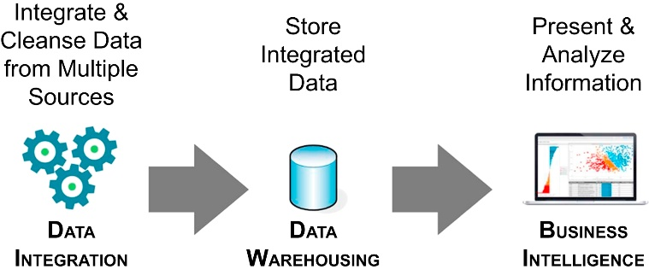
How BI, DW and DI fit together
f01-03

Slide 7
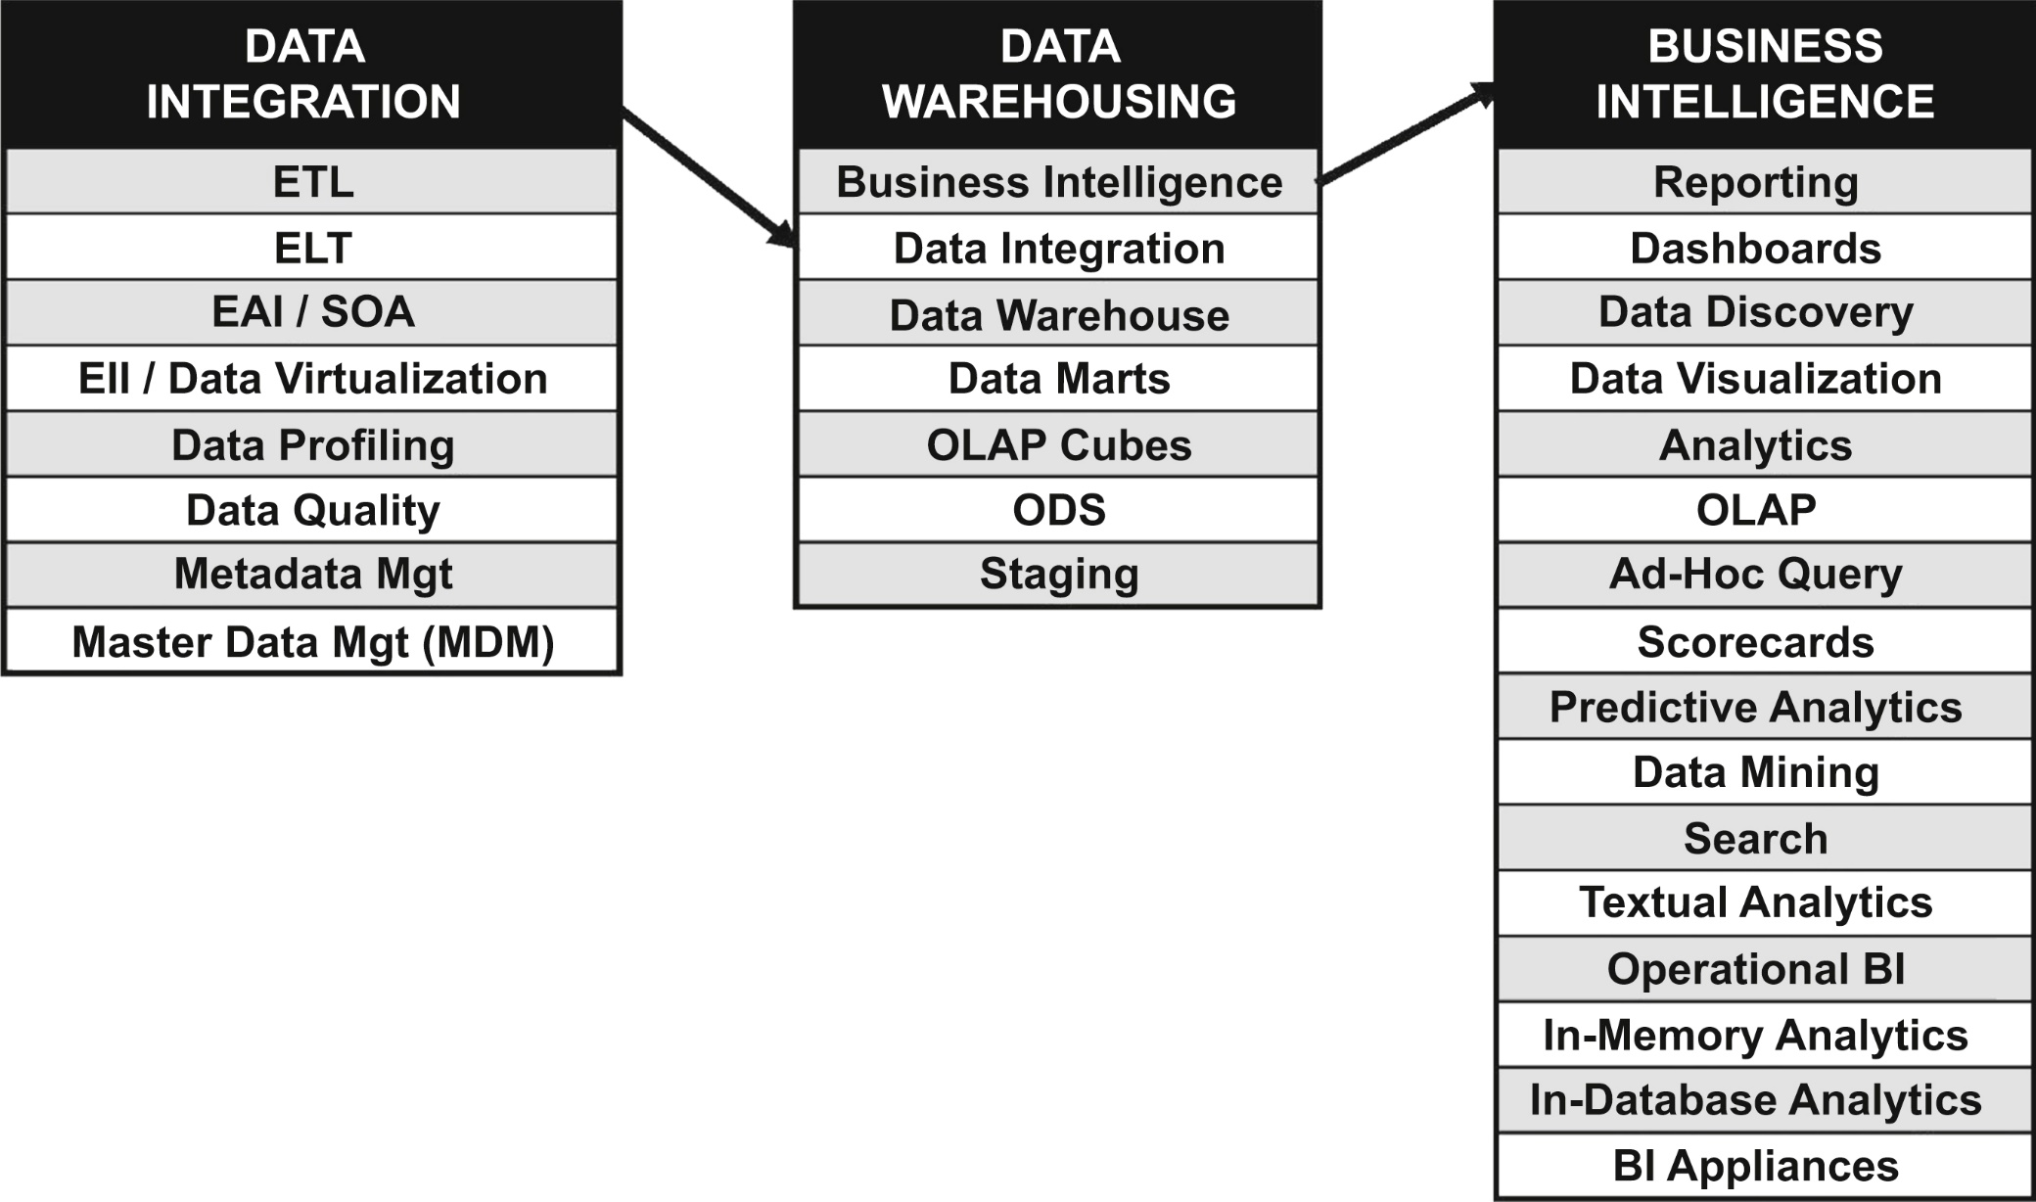
Categorizing BI, DW and DI terminology
f01-04

Slide 8
Chapter 2 Justifying BI: Building the Business and Technical Case

Slide 9
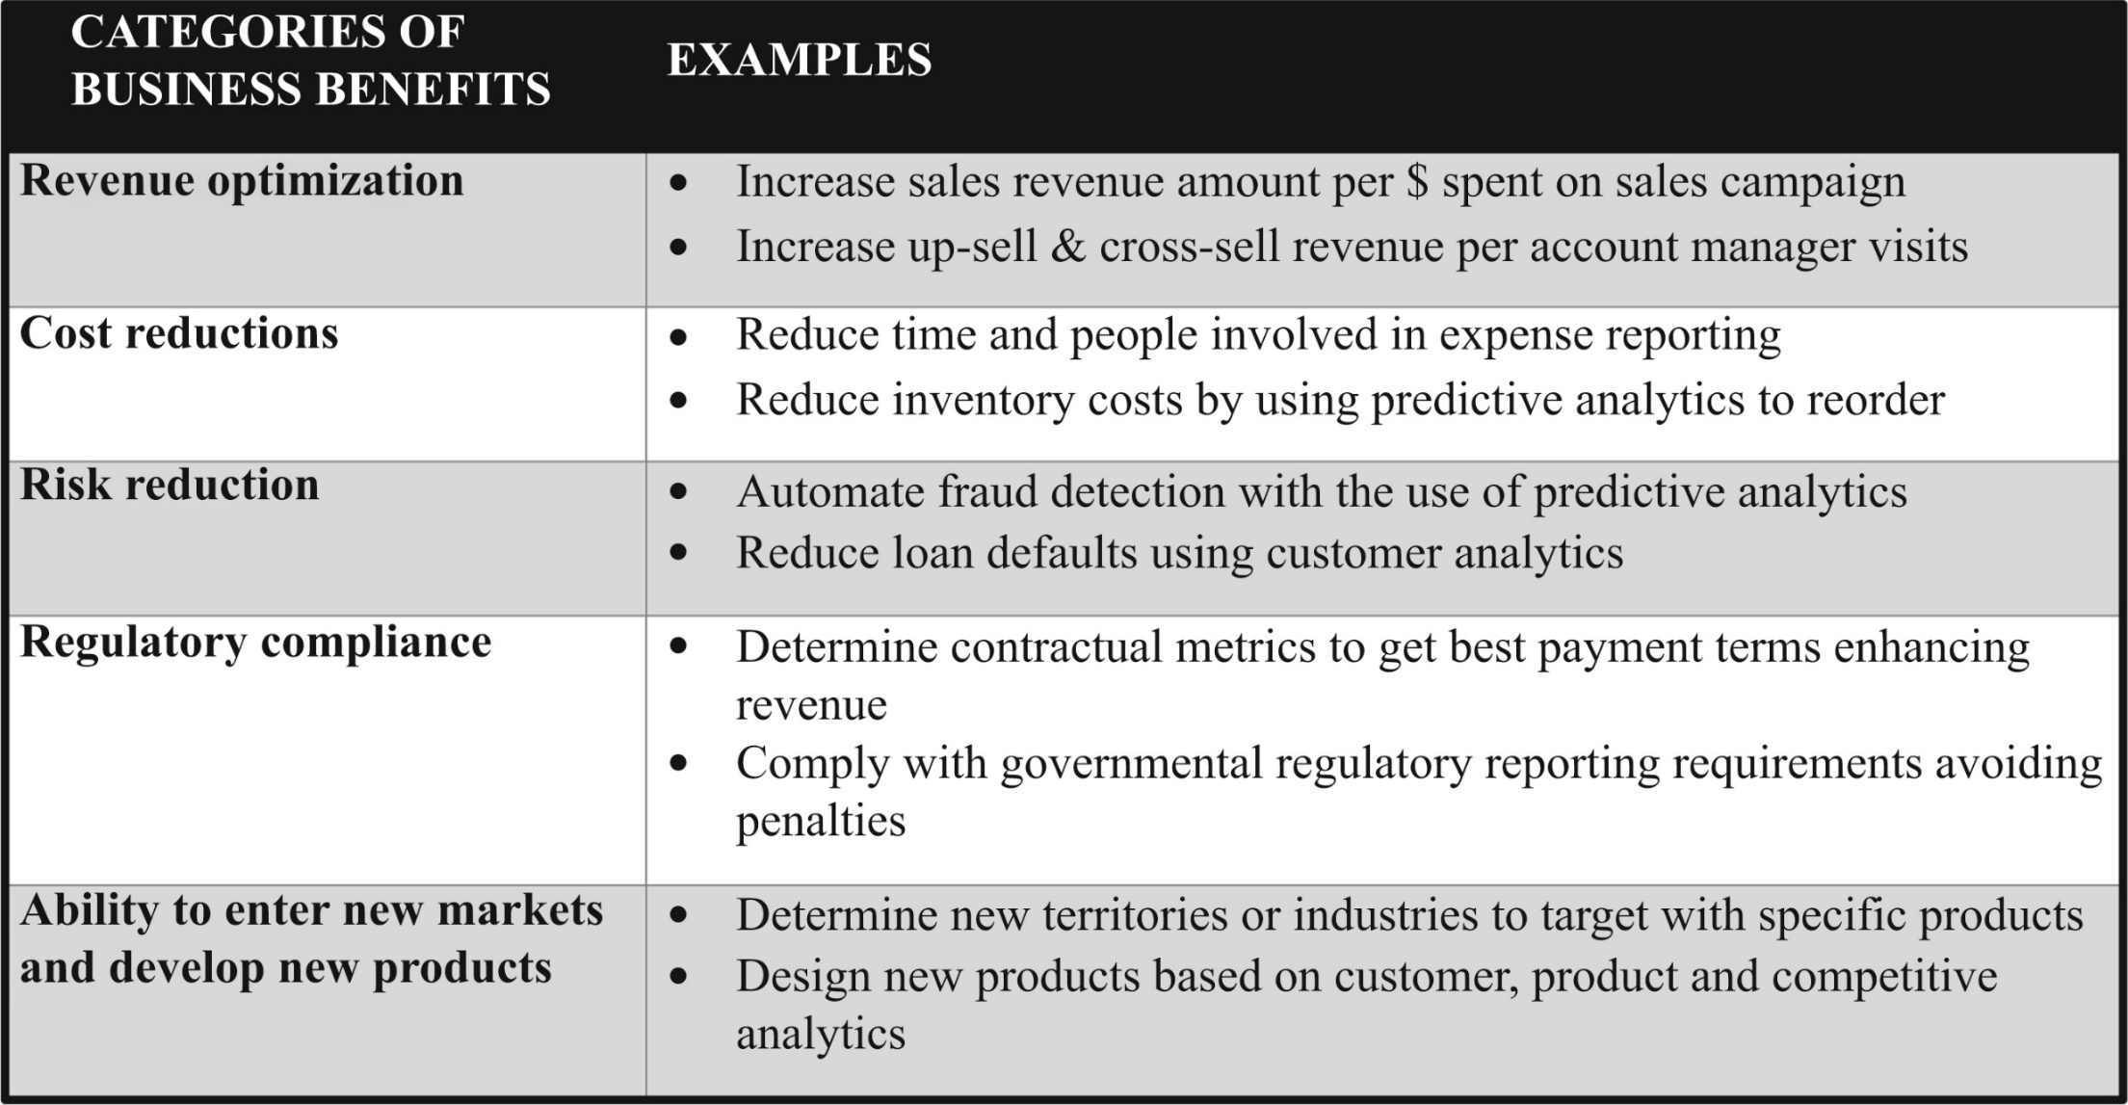
Business benefits matrix
f02-01

Slide 10
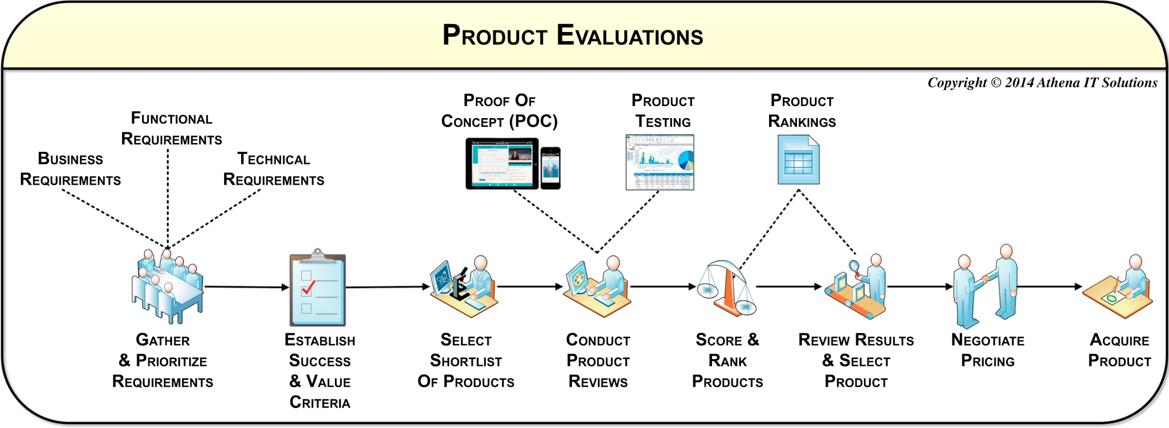
Selecting product short-list(s) workflow
f02-02

Slide 11
Chapter 3 Defining Requirements – Business, Data and Quality

Slide 12
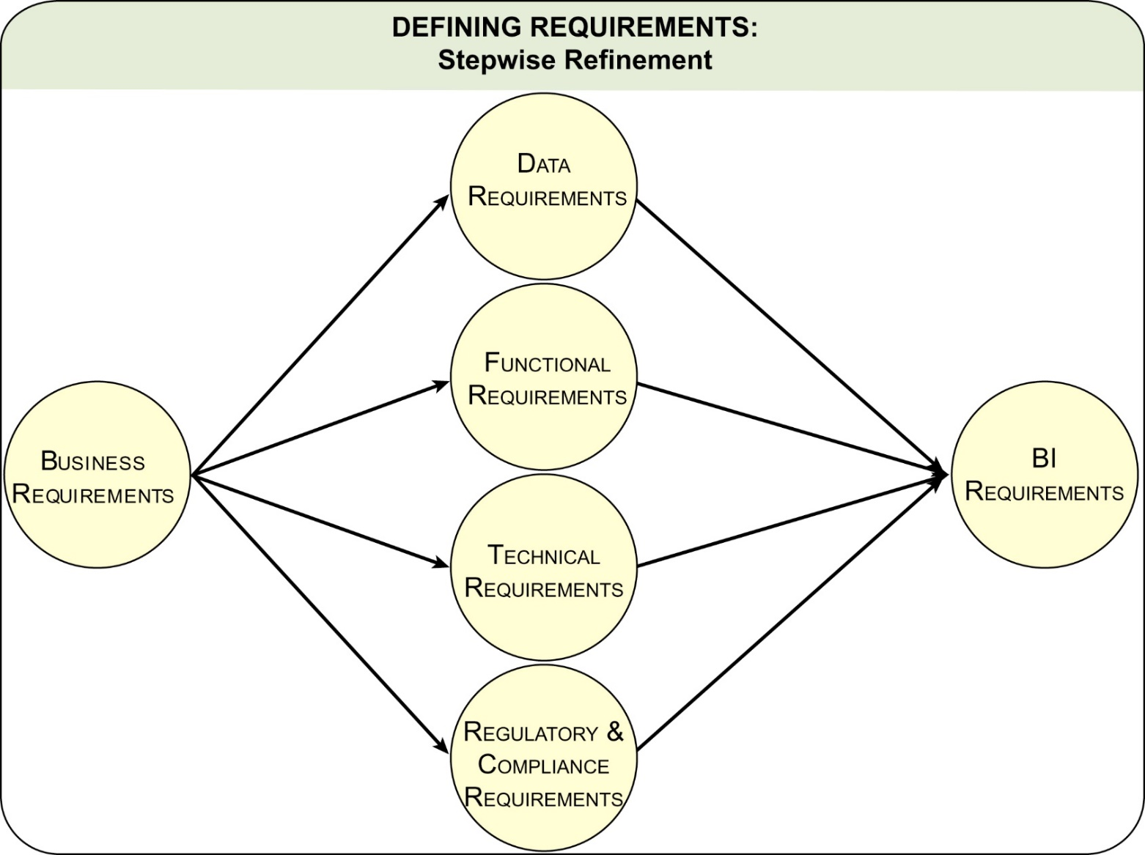
Requirements – stepwise refinement
f03-01

Slide 13
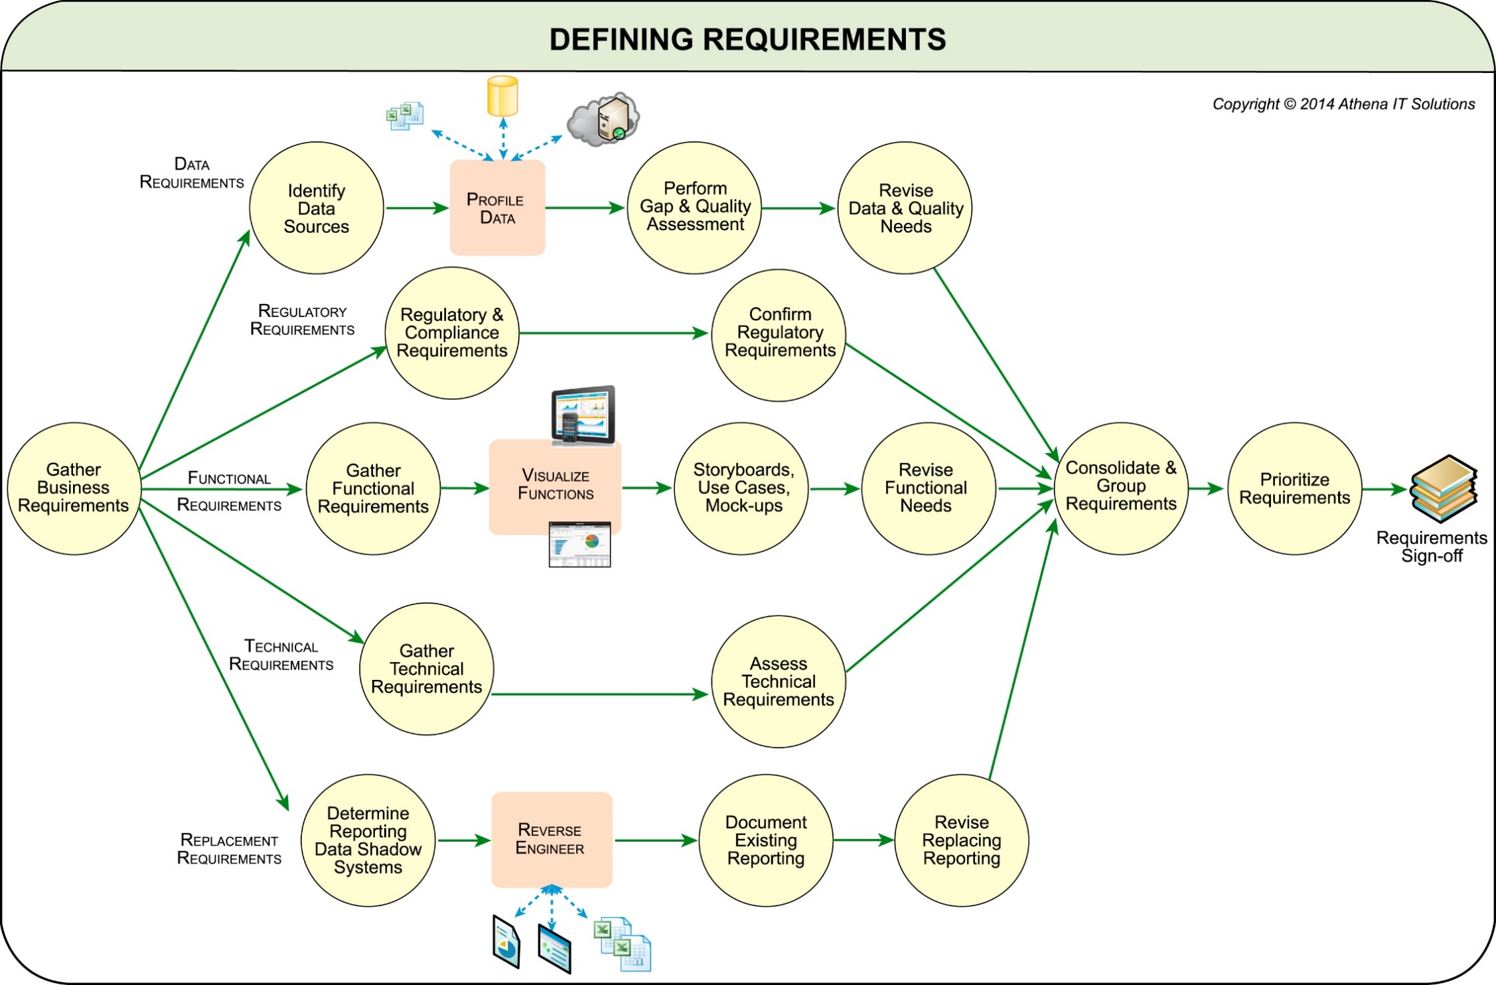
Defining requirements workflow
f03-02

Slide 14
Chapter 4 Architecture Framework

Slide 15
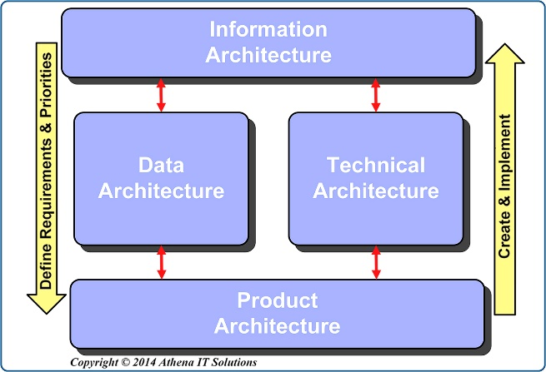
The four architecture categories
f04-01

Slide 16
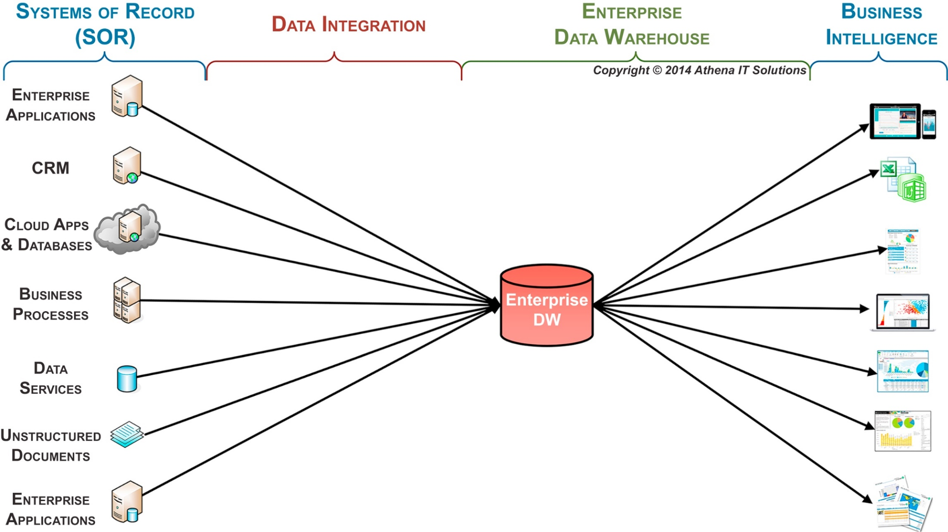
Enterprise data warehouse
f04-02

Slide 17
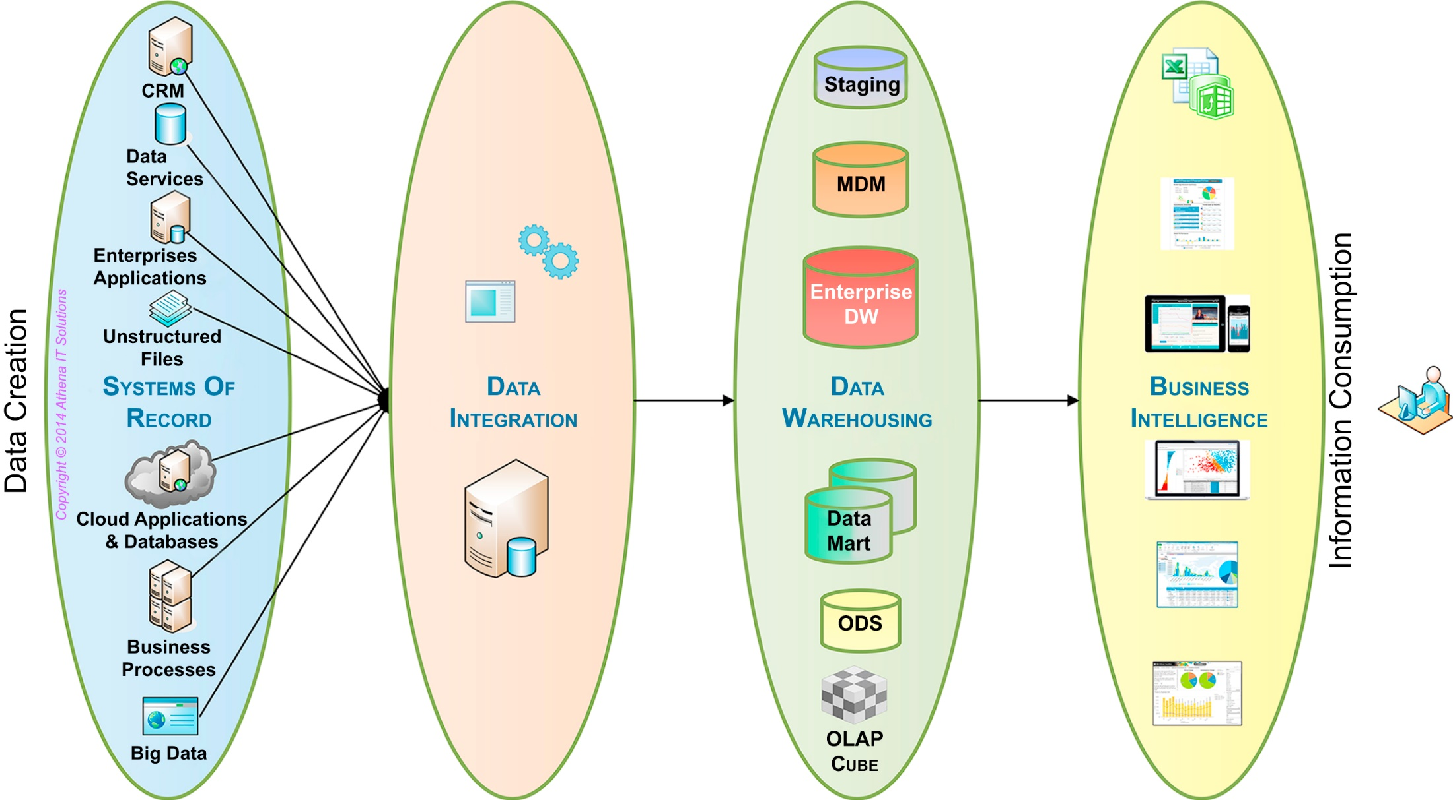
Data architecture workflow
f04-03

Slide 18
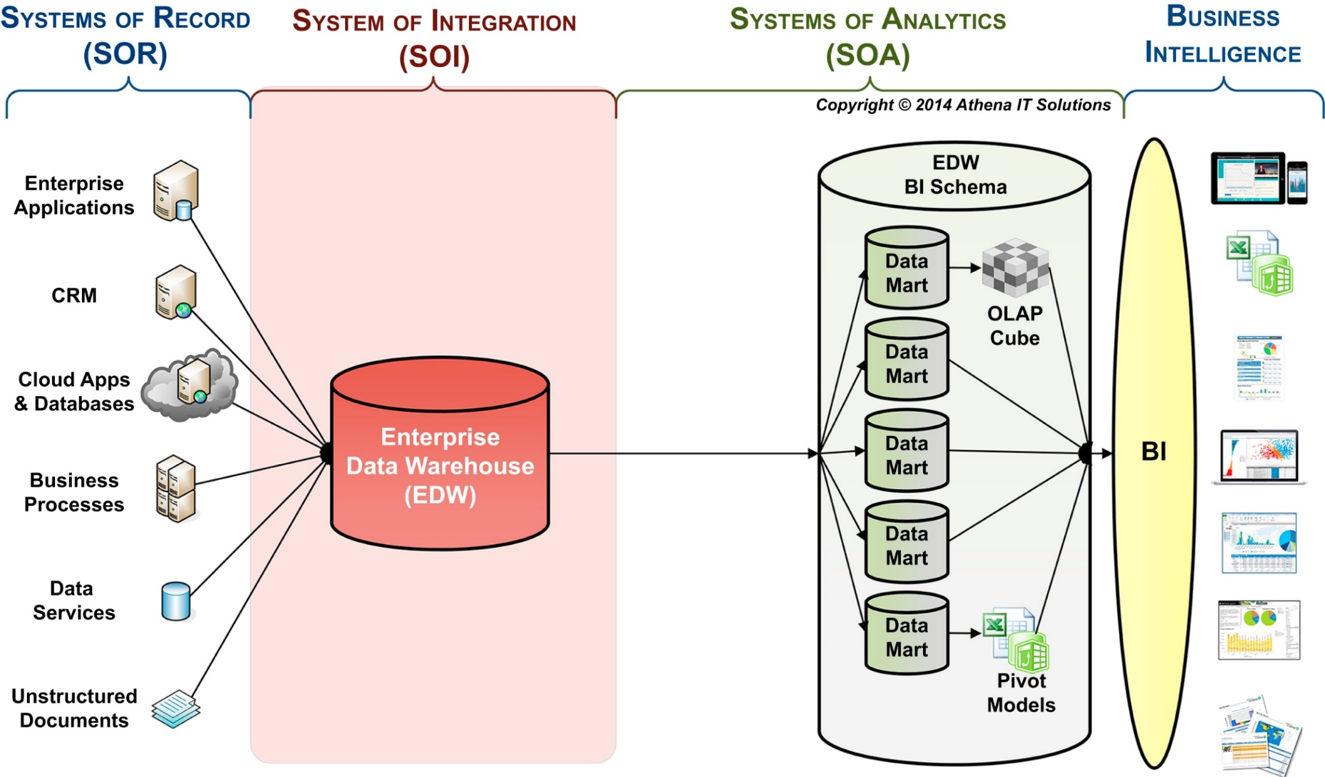
BI data architecture – roles of data systems
f04-04

Slide 19
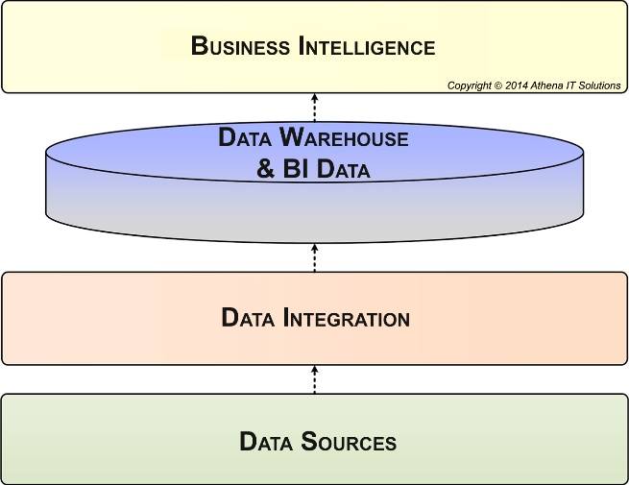
BI technical architecture
f04-05

Slide 20
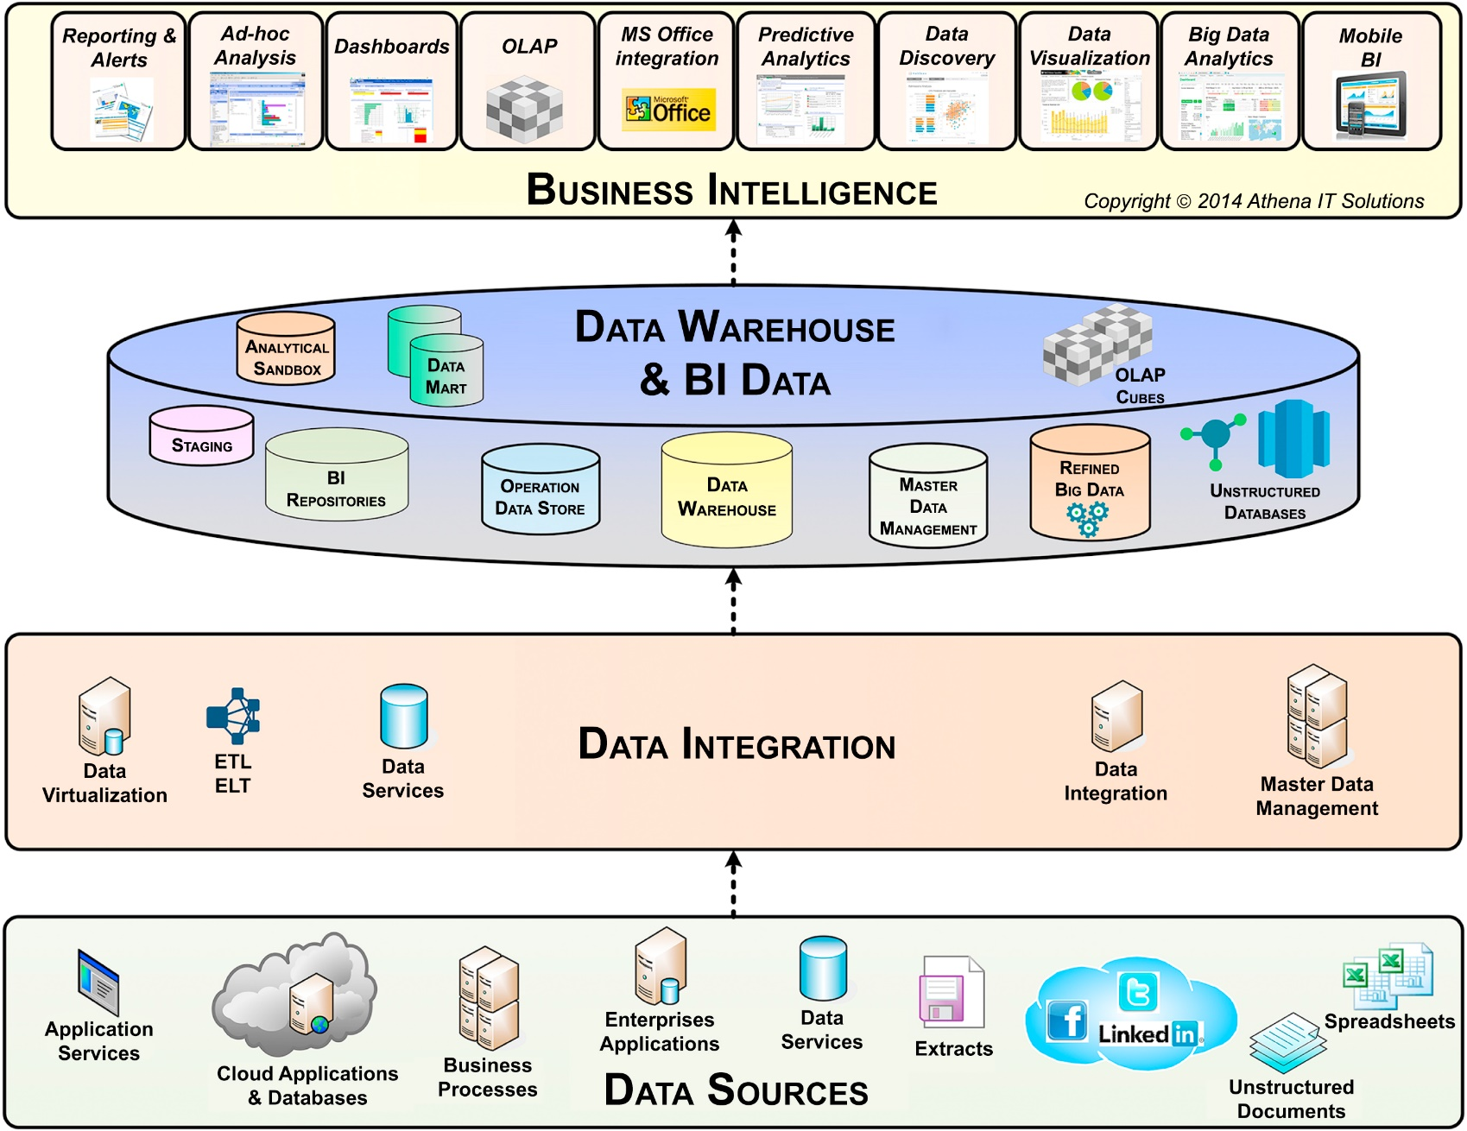
BI technical architecture categories
f04-06

Slide 21
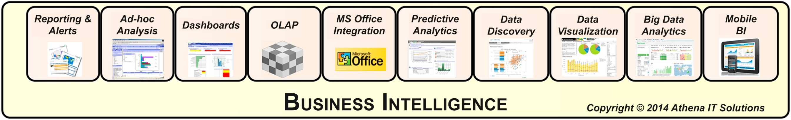
BI analytical styles
f04-07

Slide 22
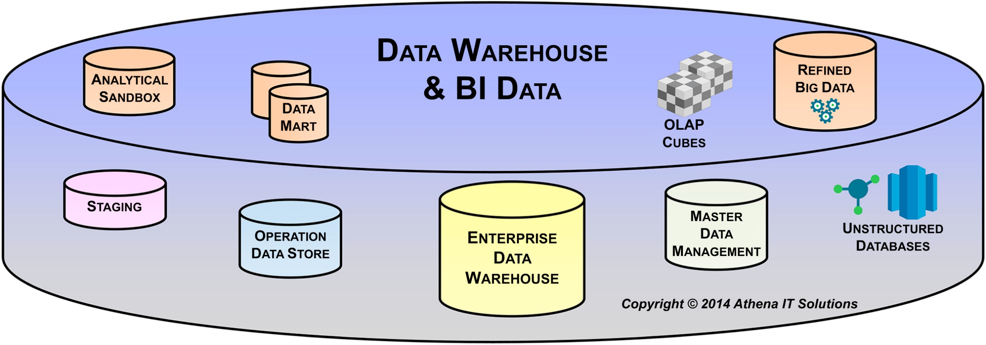
Data warehouse and BI data store layer
f04-08

Slide 23
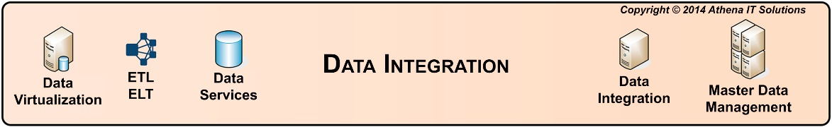
Data integration layer
f04-09

Slide 24
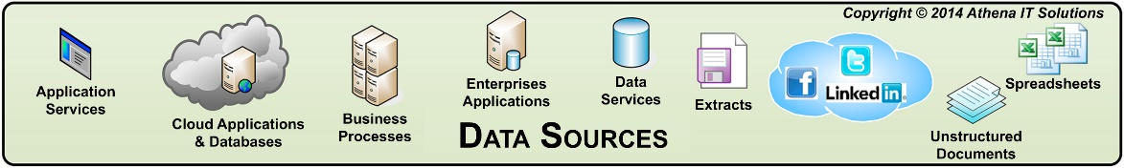
Data sources layer
f04-10

Slide 25
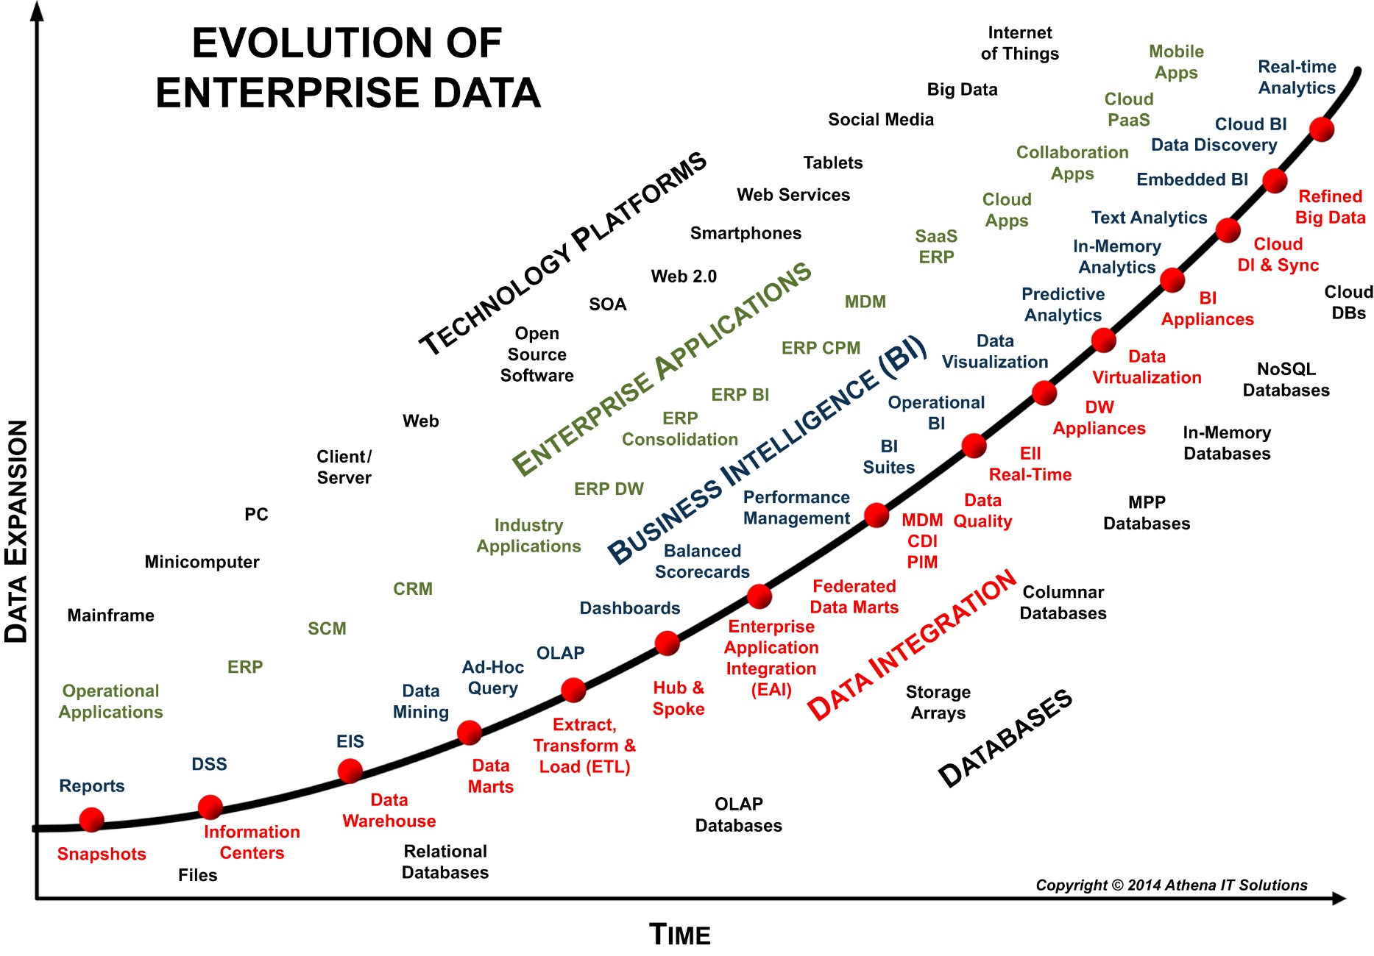
Evolution of data technology over time
f04-11

Slide 26
Chapter 5 Information Architecture

Slide 27
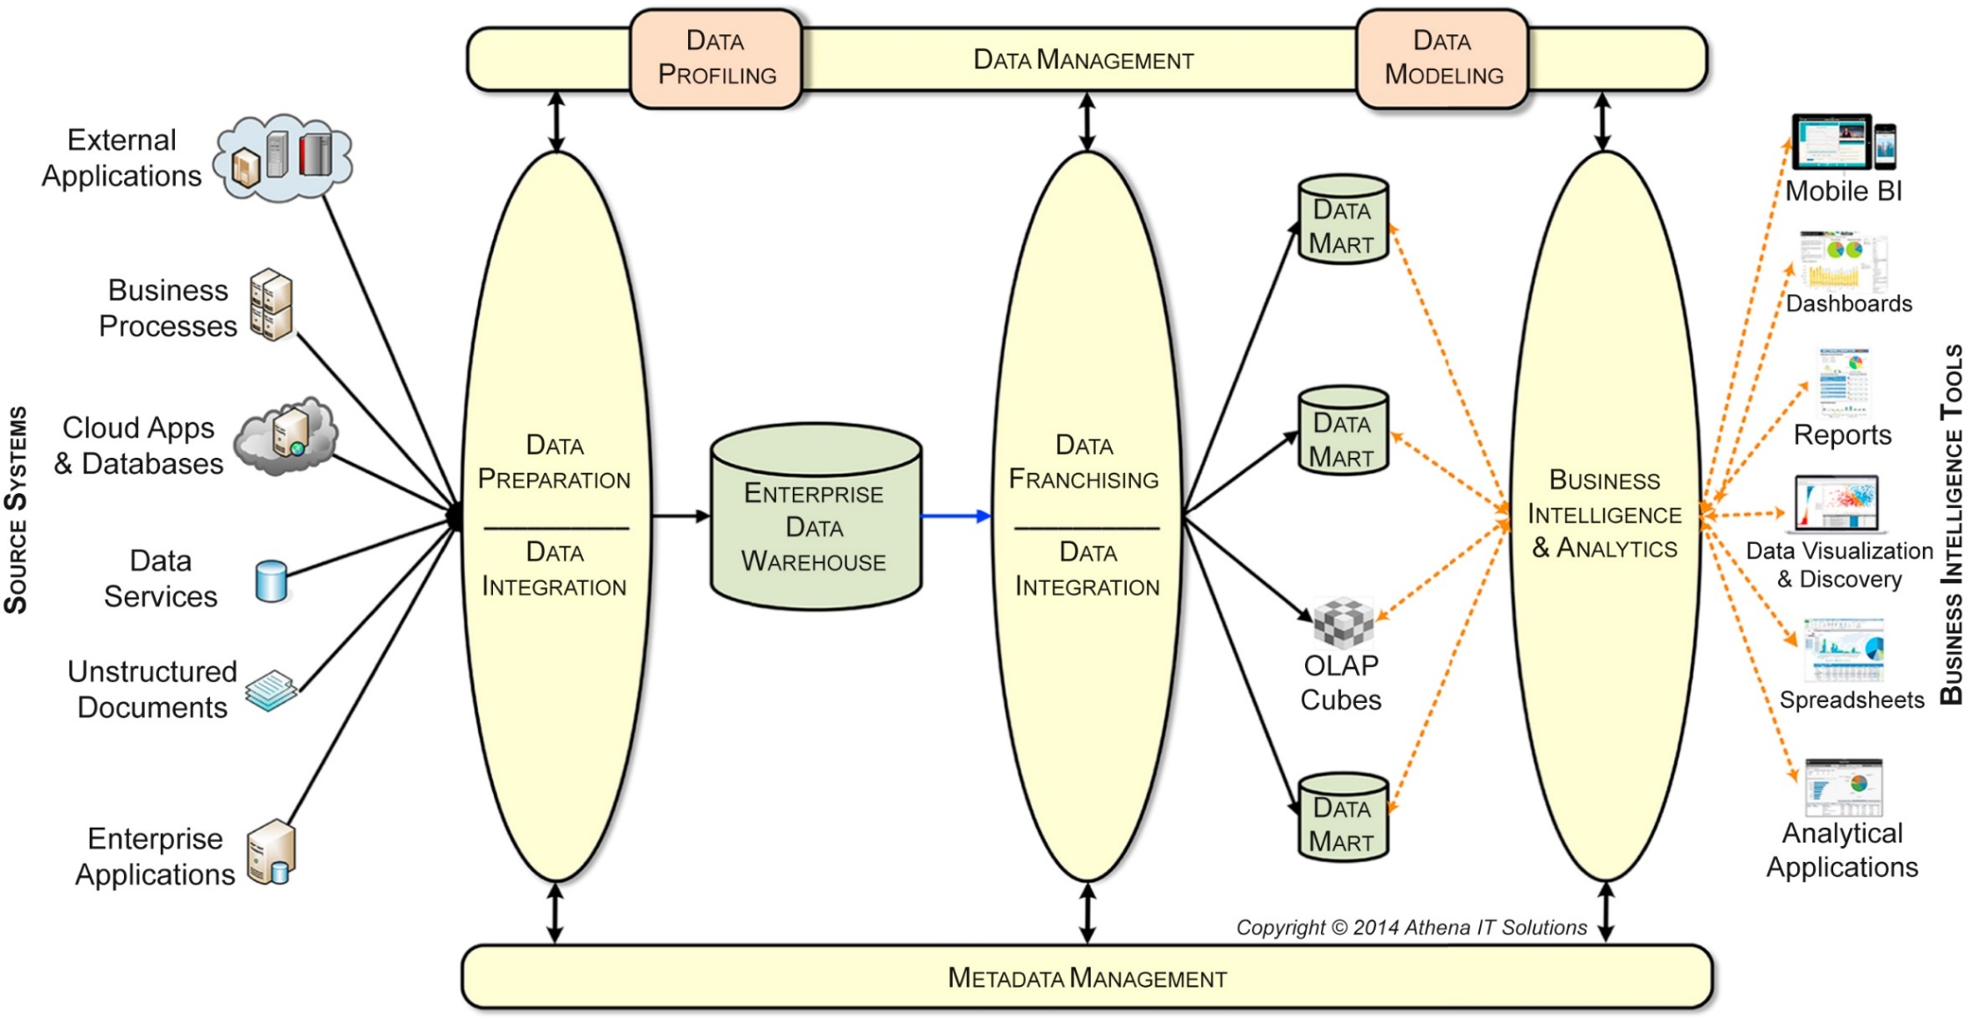
Data integration framework (DIF) information architecture
f05-01

Slide 28
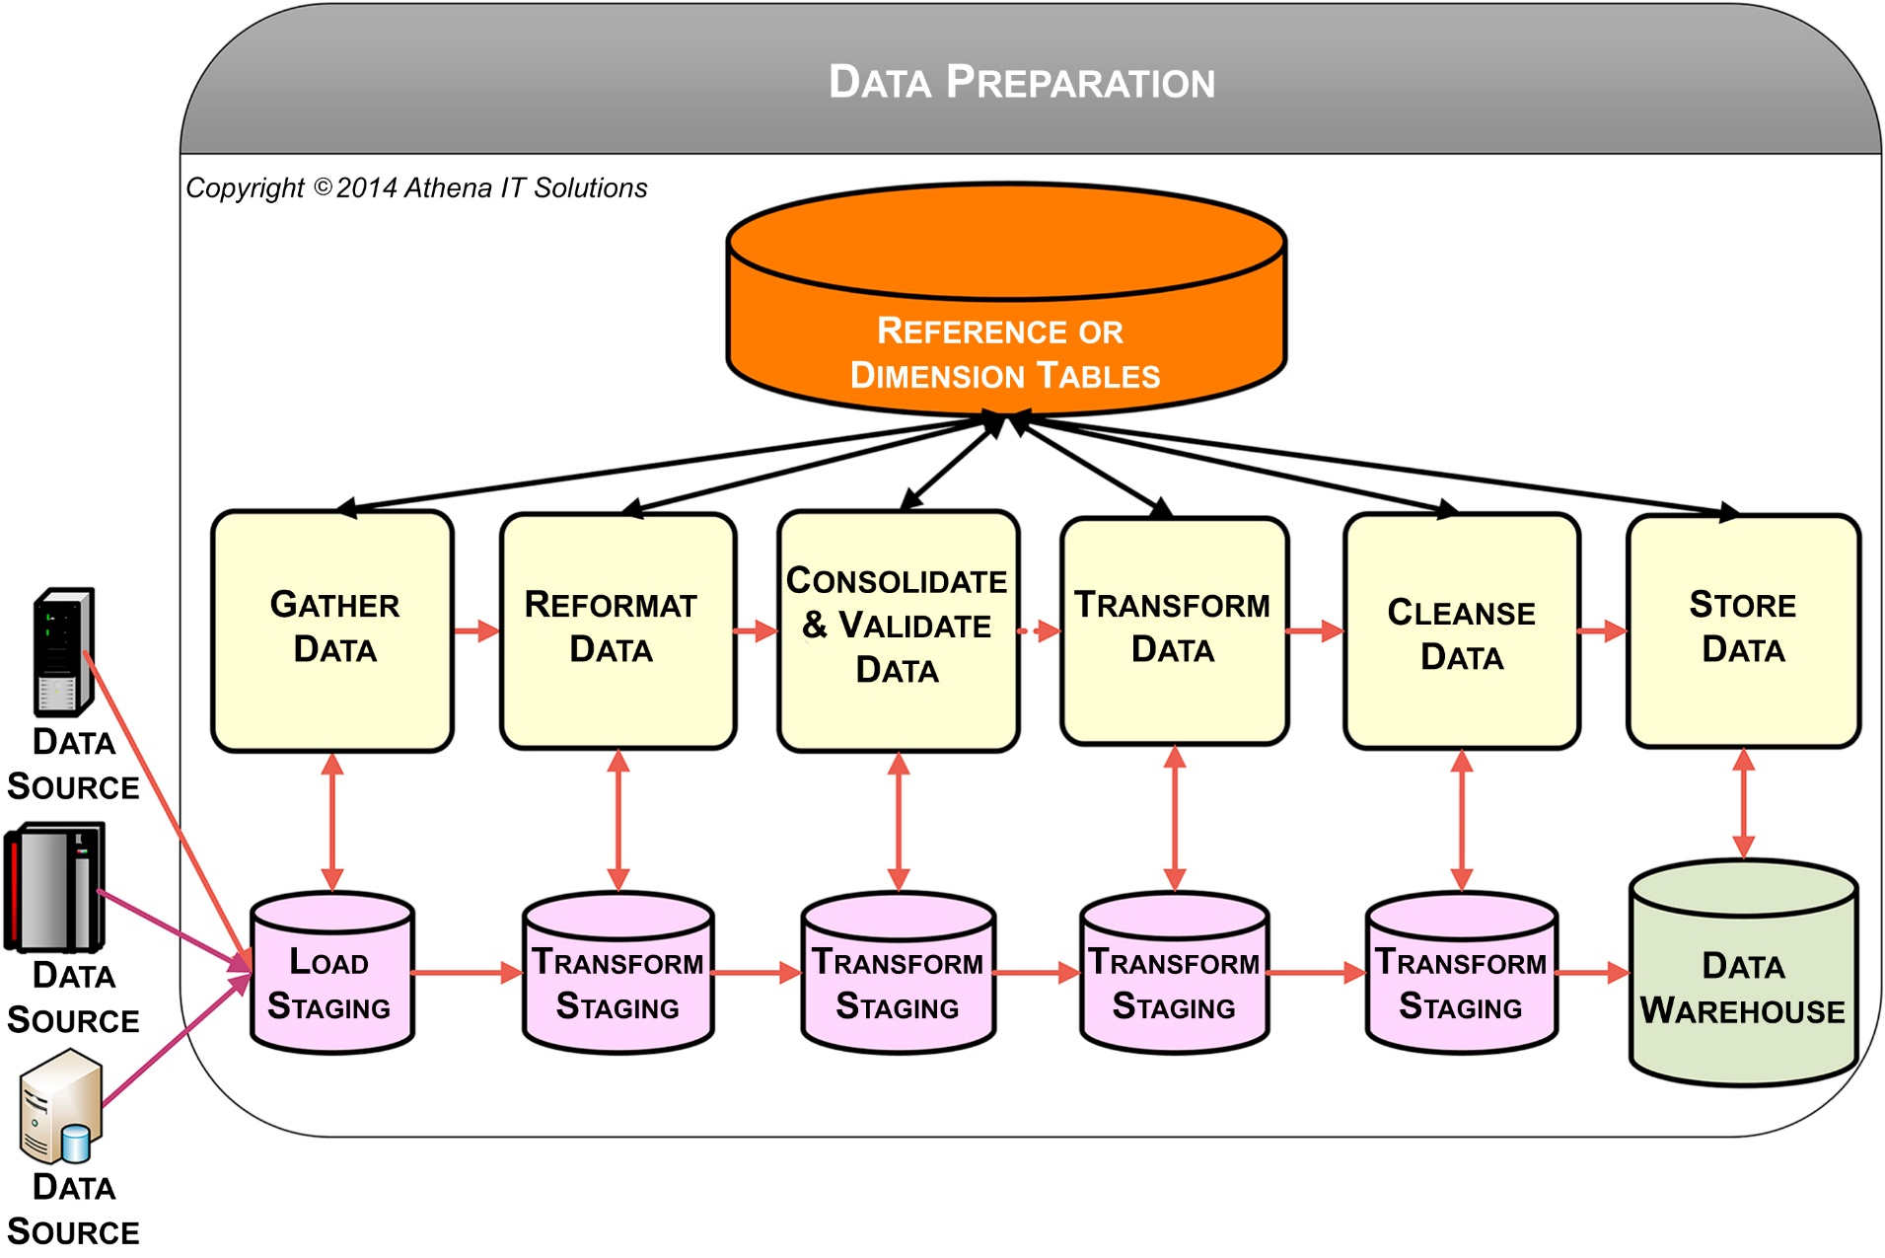
Data preparation process
f05-02

Slide 29
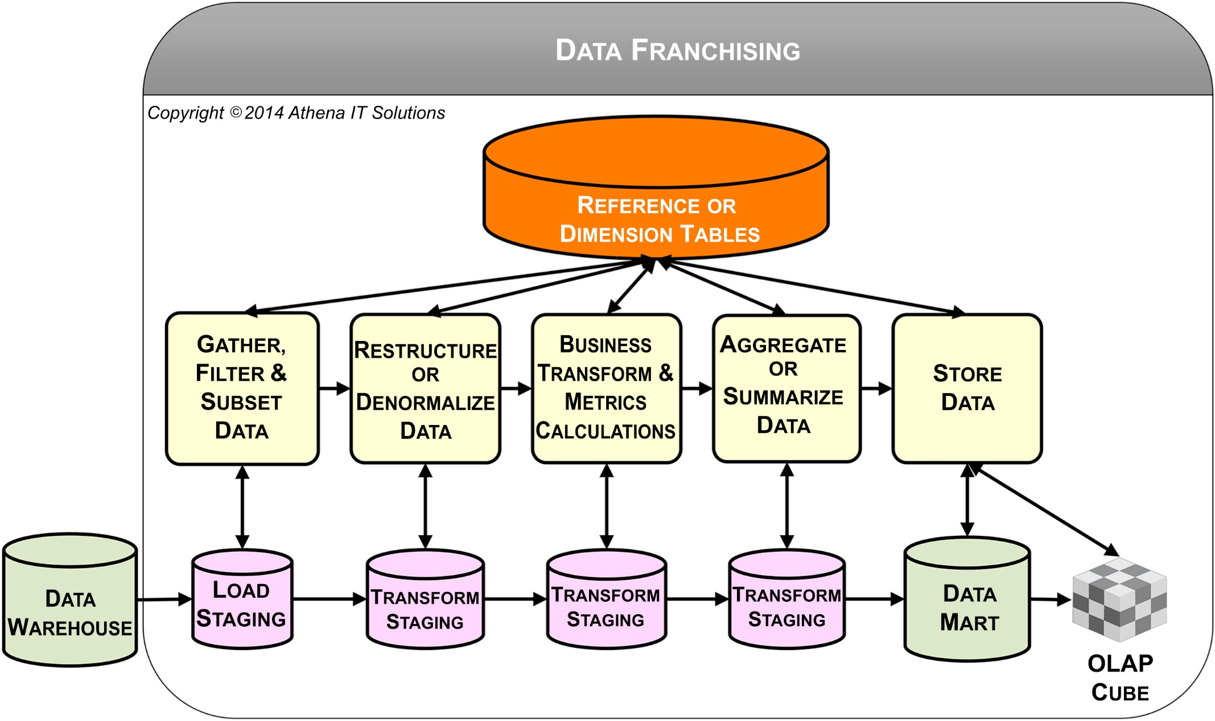
Data franchising processes
f05-03

Slide 30
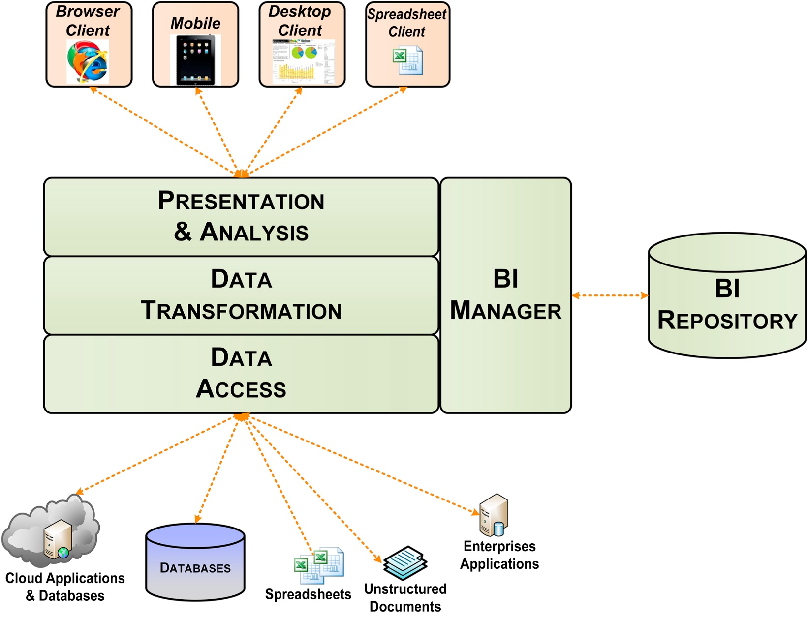
BI tool components
f05-04

Slide 31
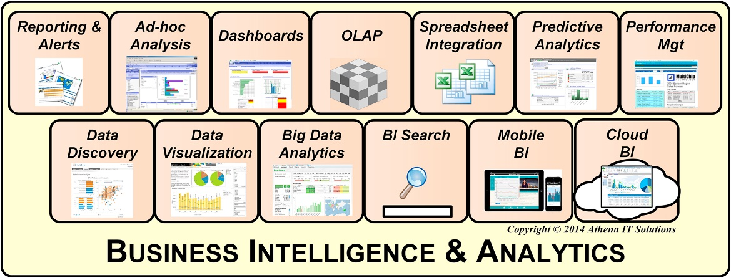
BI interface analytical styles
f05-05

Slide 32
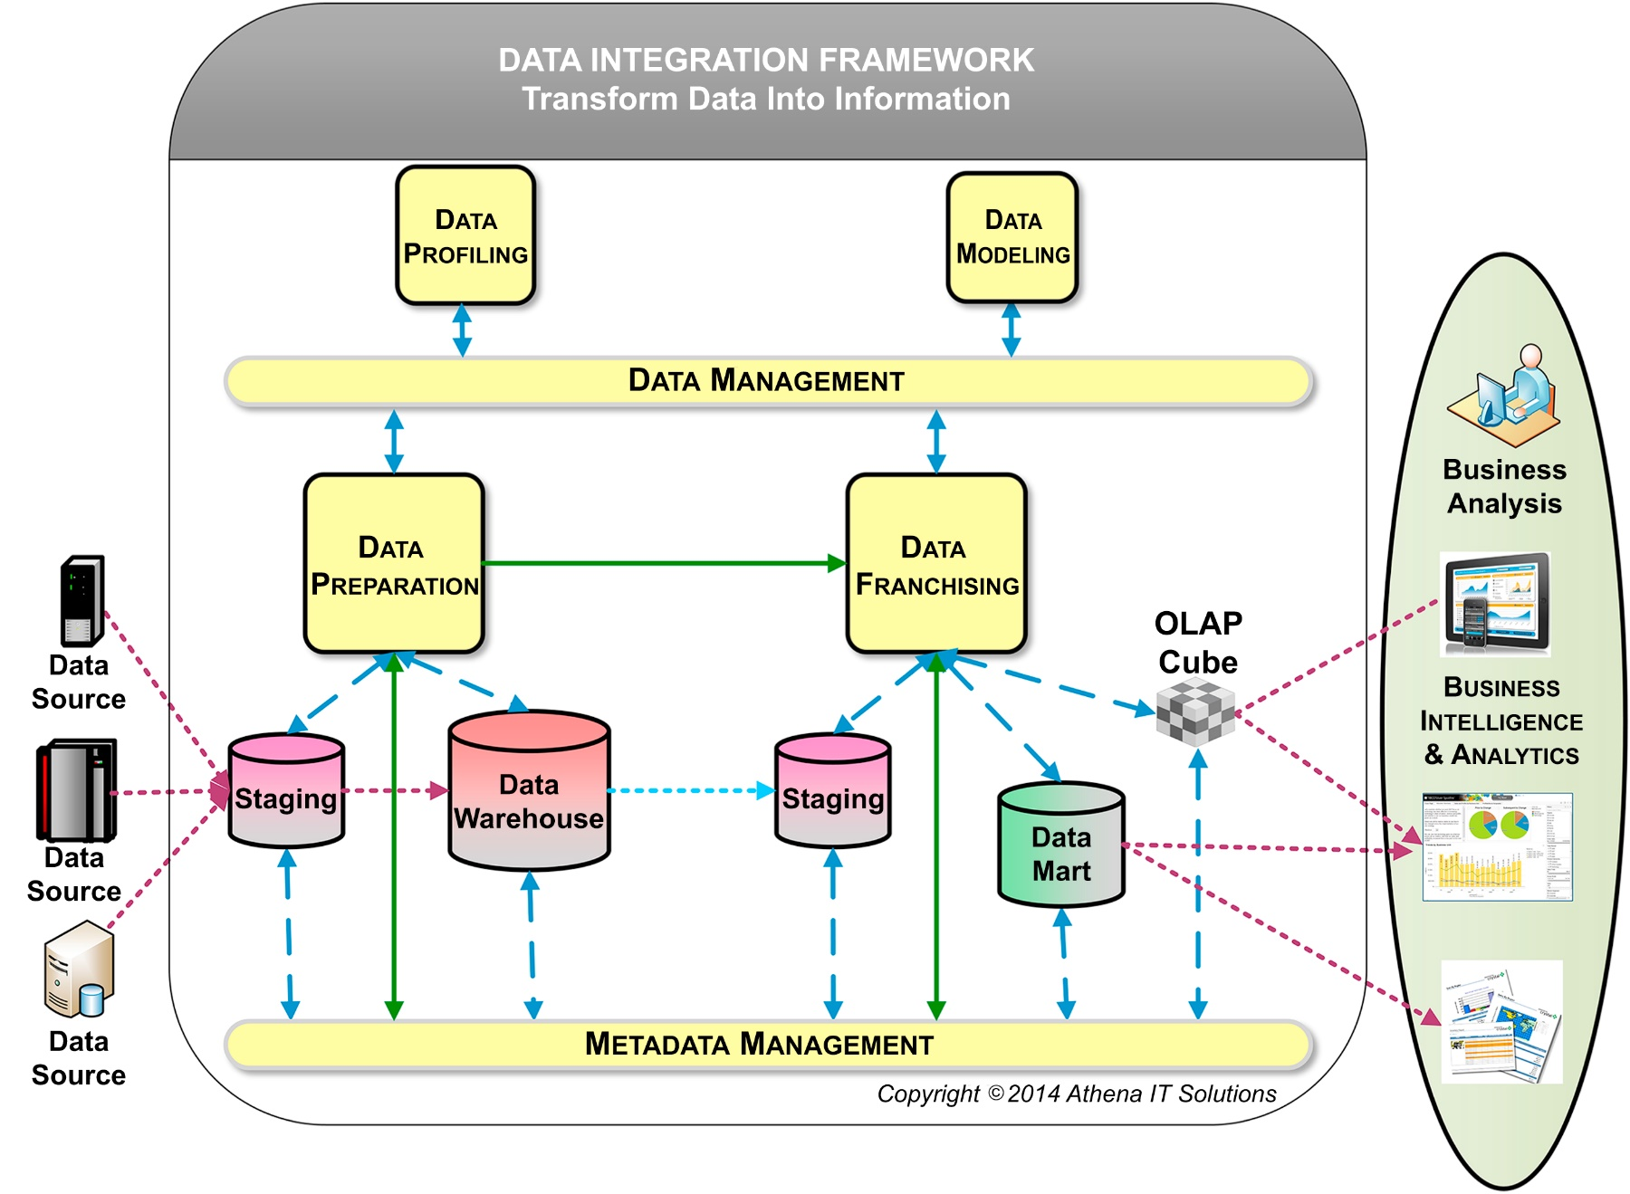
Data management processes
f05-06

Slide 33
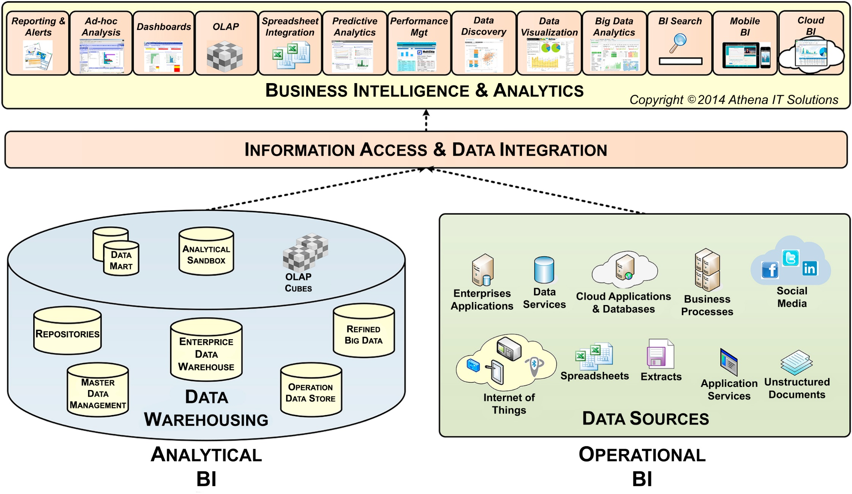
Blended BI environment
f05-07

Slide 34
Chapter 6 Data Architecture

Slide 35
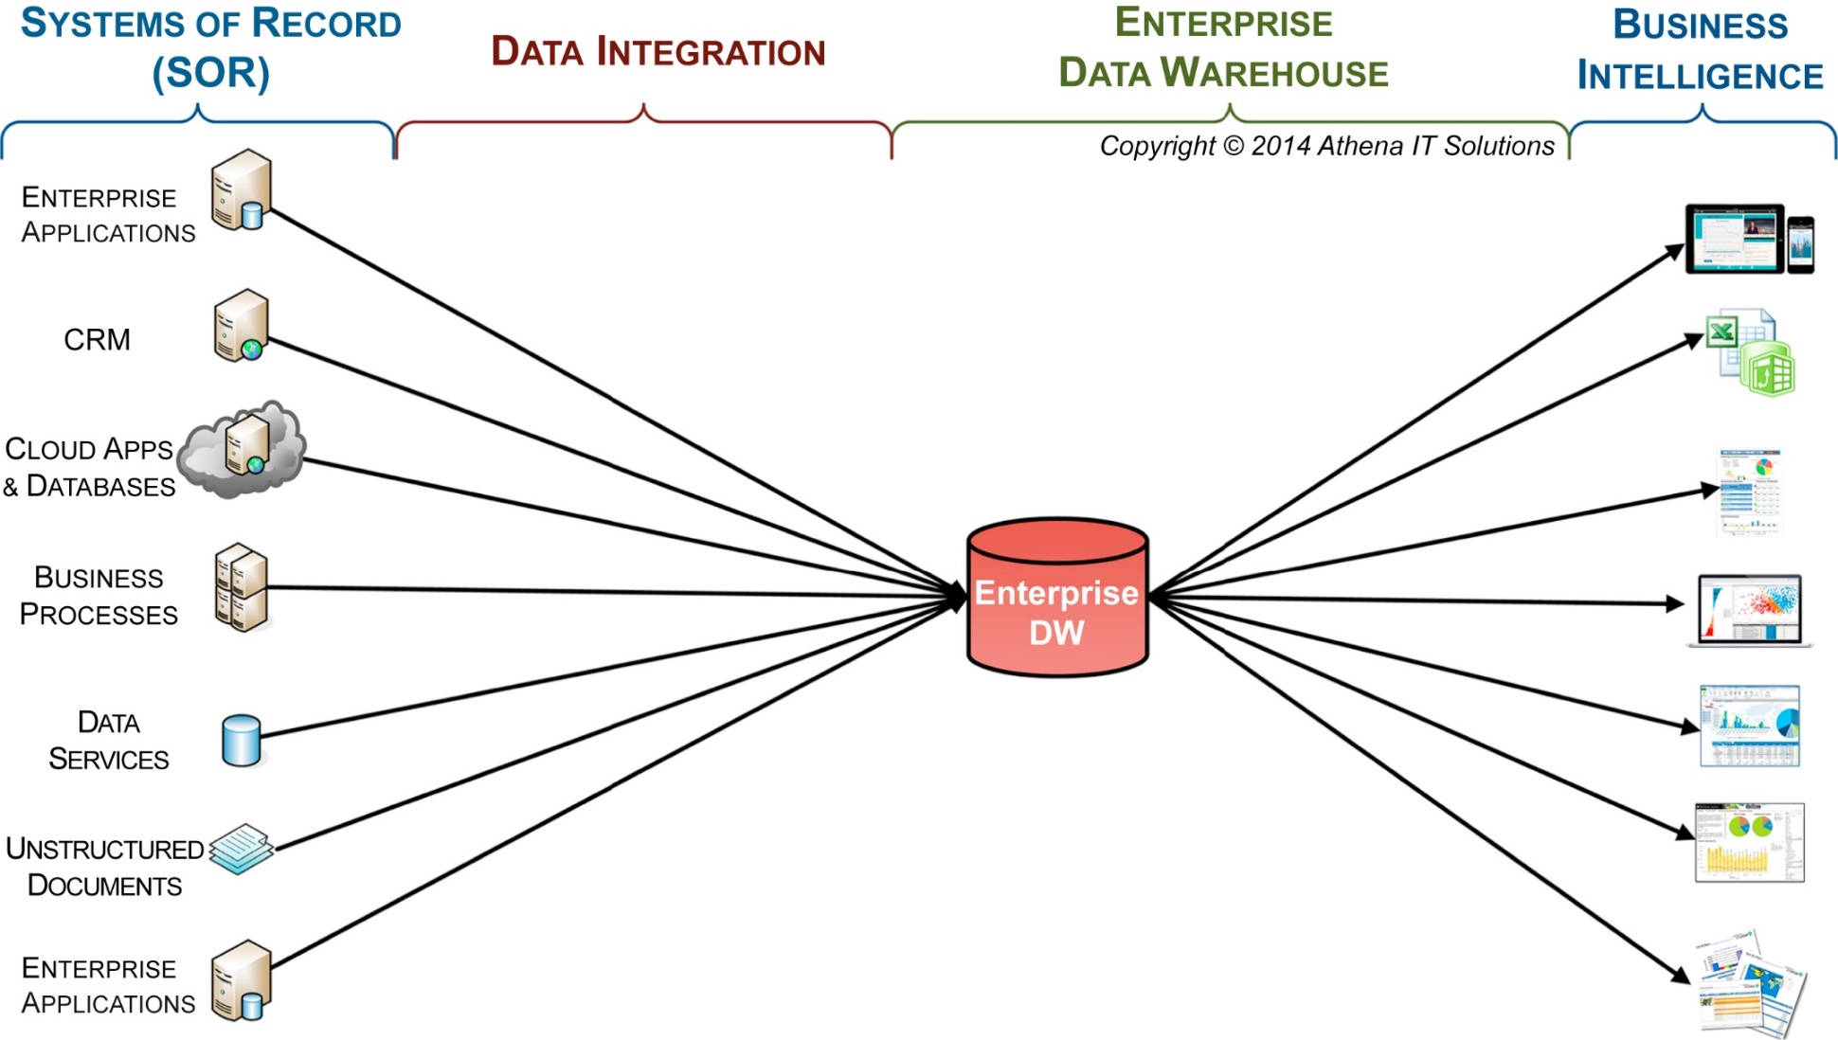
Enterprise data warehouse (EDW)
f06-01

Slide 36
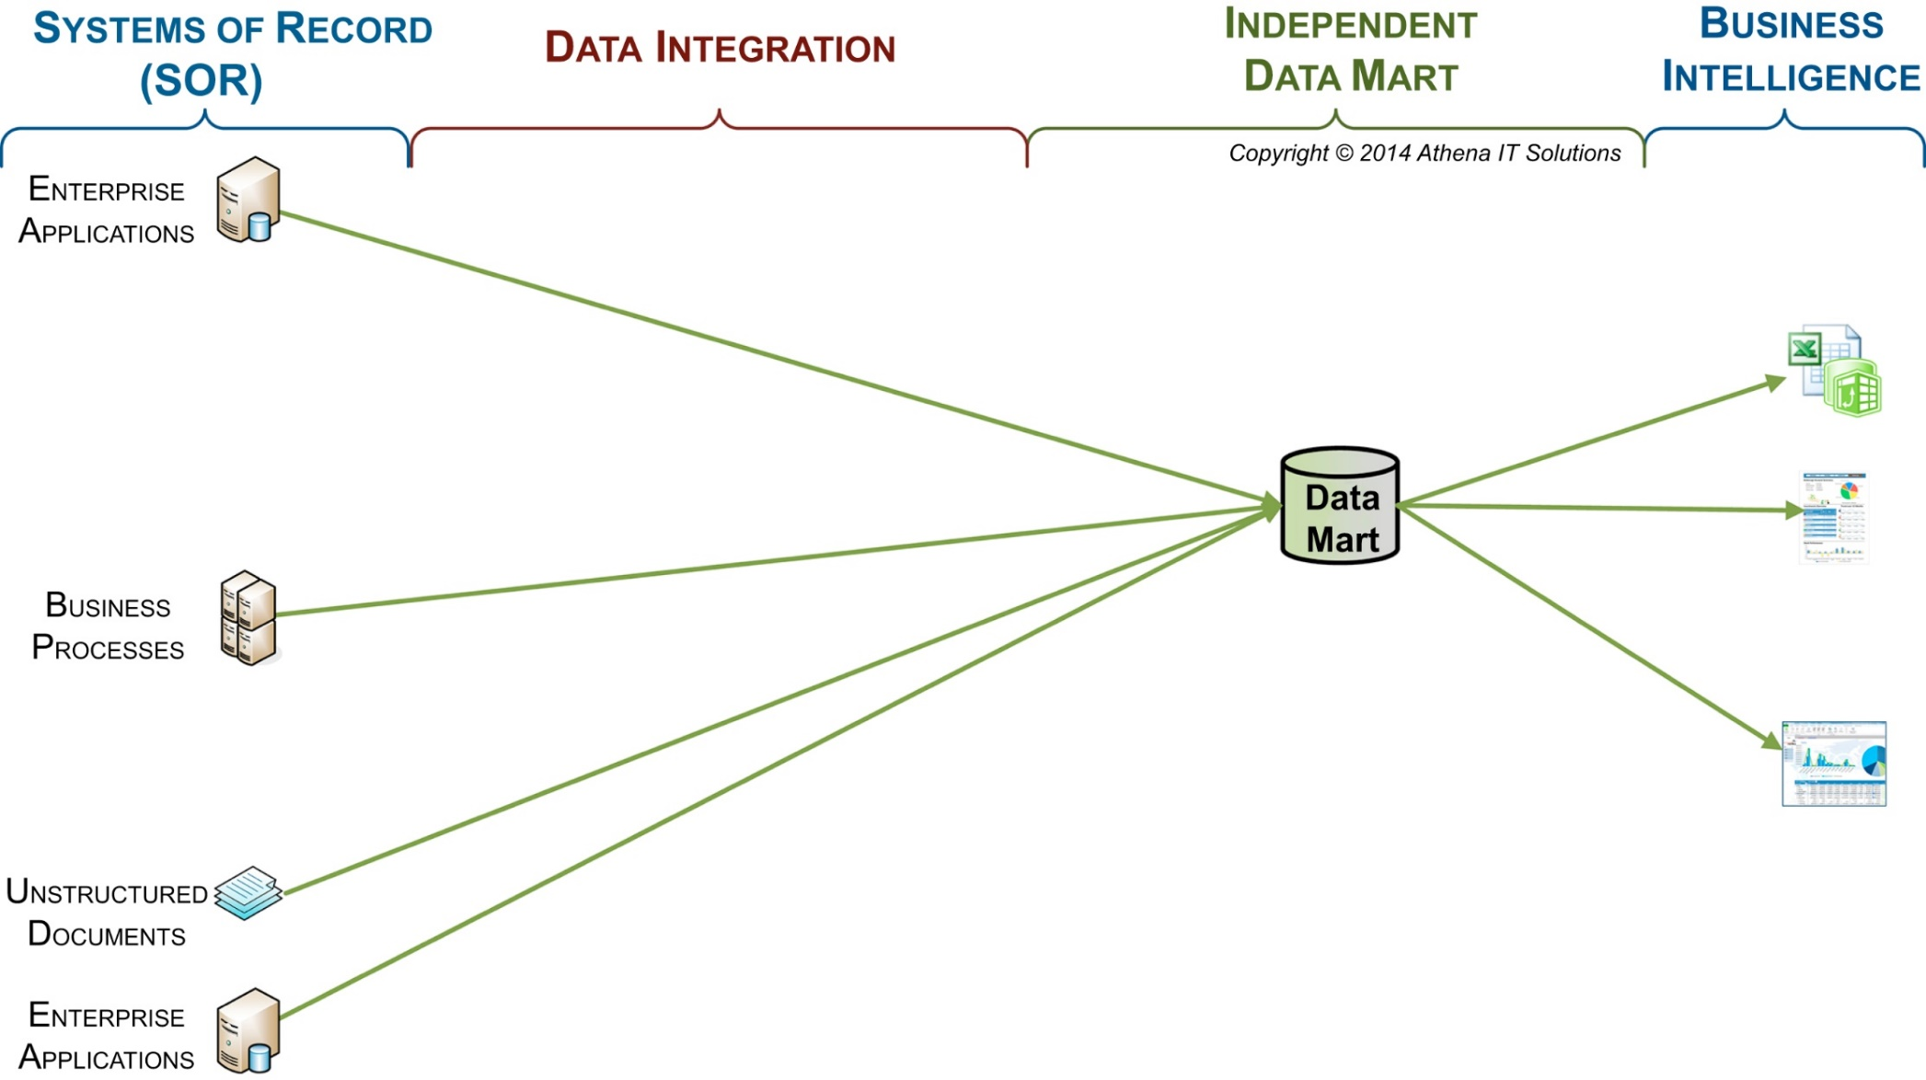
Data mart
f06-02

Slide 37
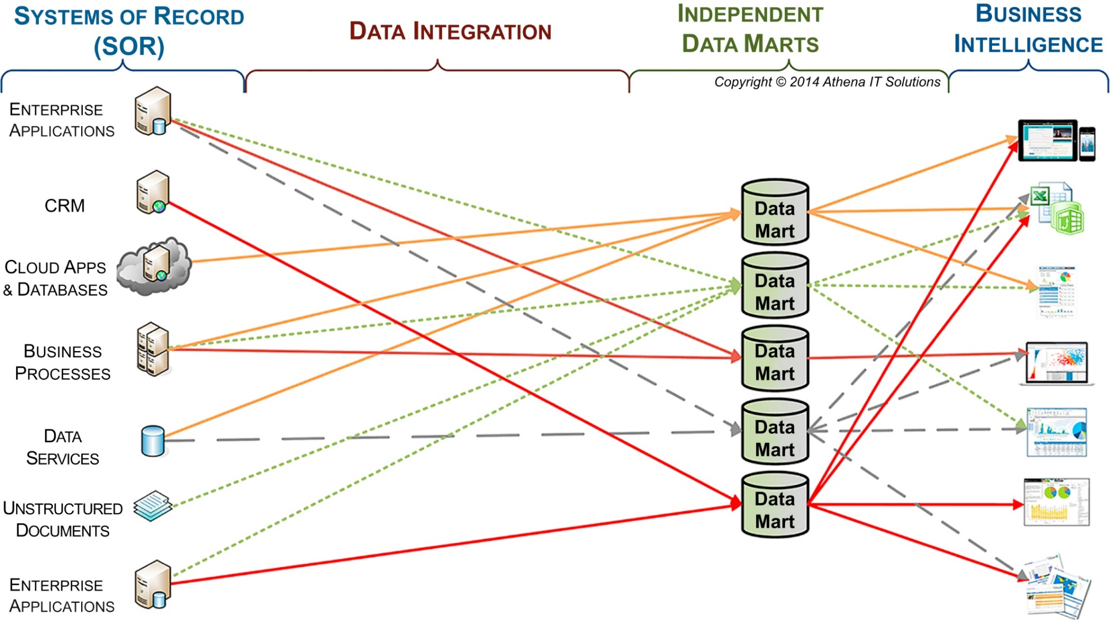
Multiple independent data marts
f06-03

Slide 38
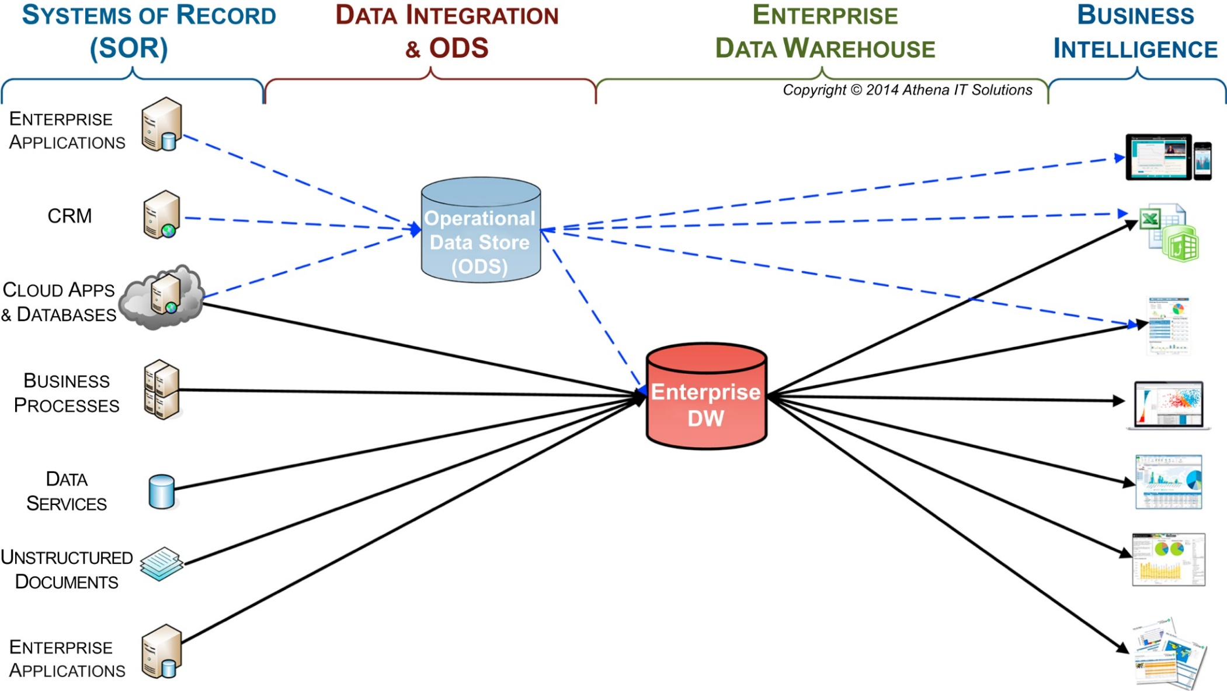
Operational data store
f06-04

Slide 39
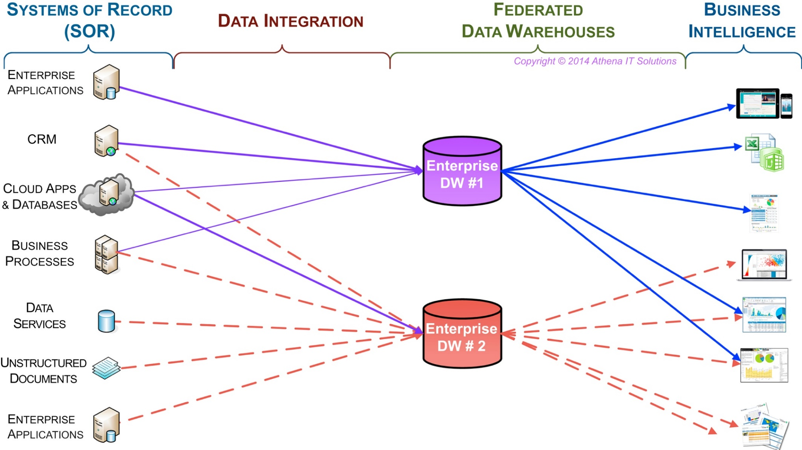
Federated data warehouses
f06-05

Slide 40
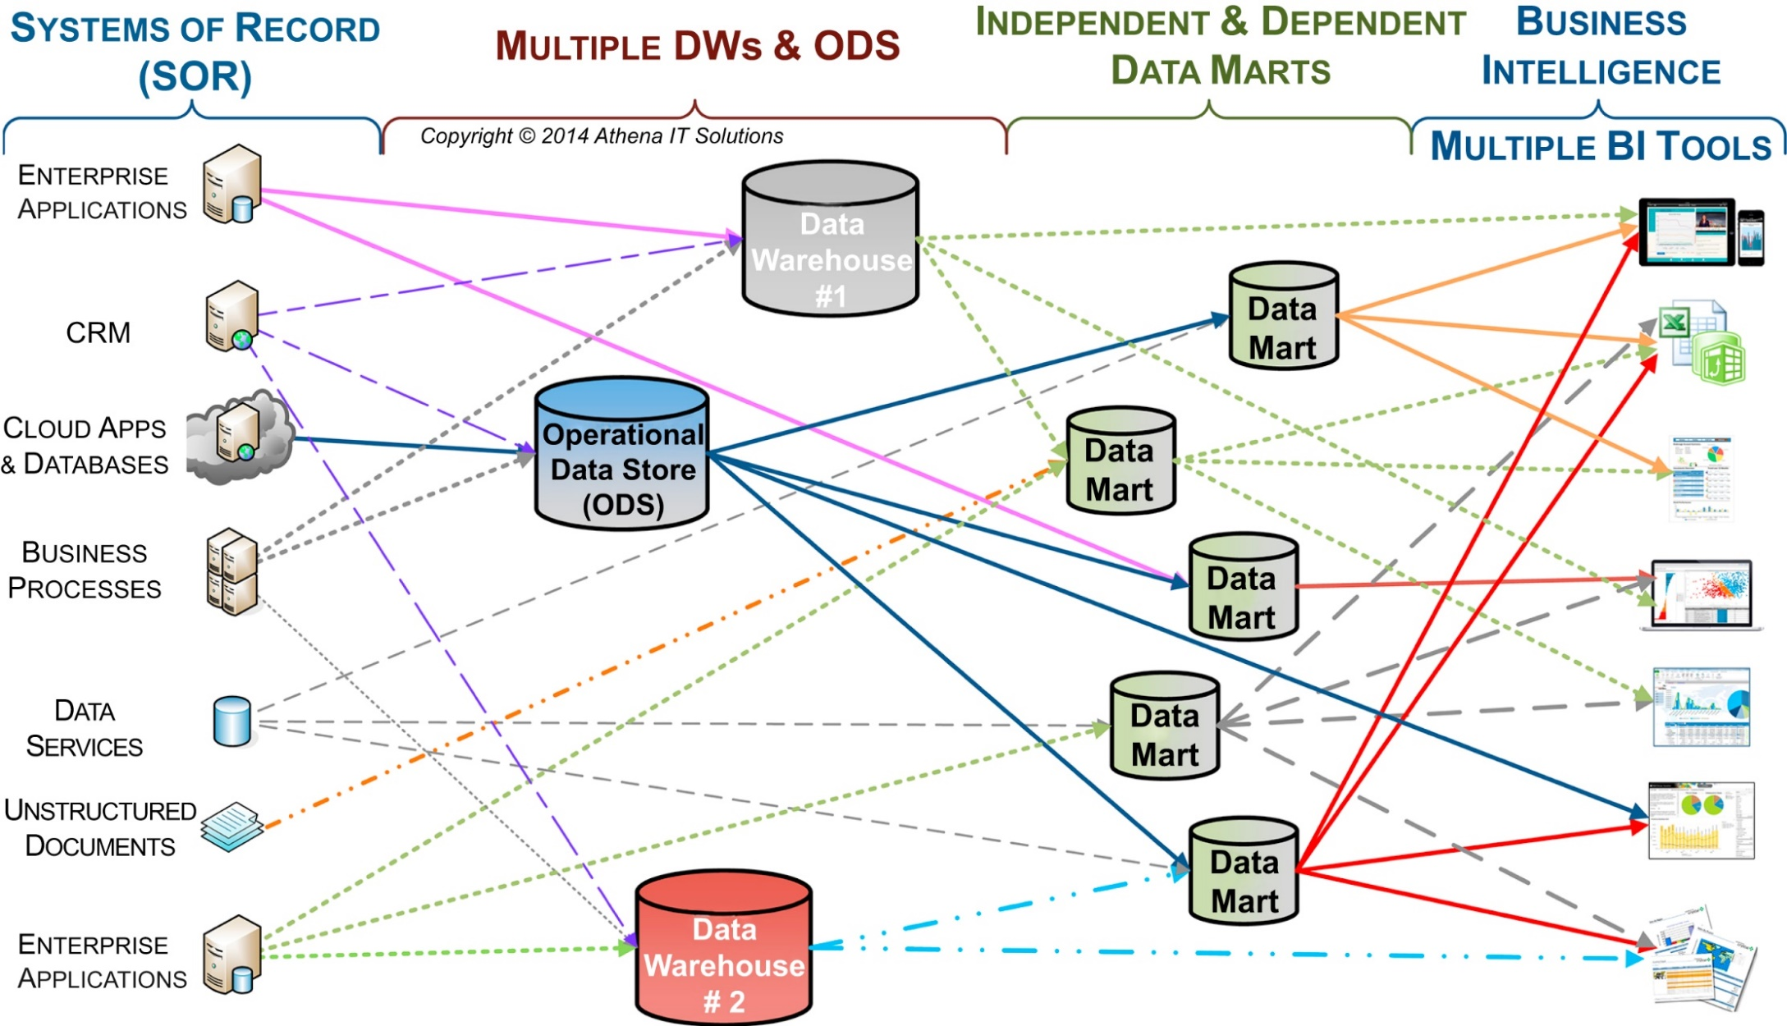
Multiple built BI silos & multiple BI tools
f06-06

Slide 41
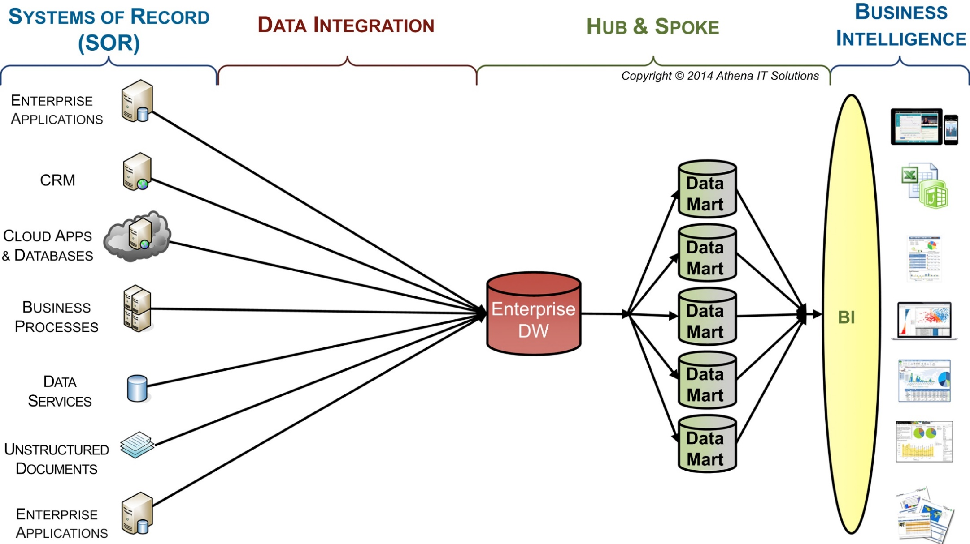
Hub & Spoke with one BI platform
f06-07

Slide 42
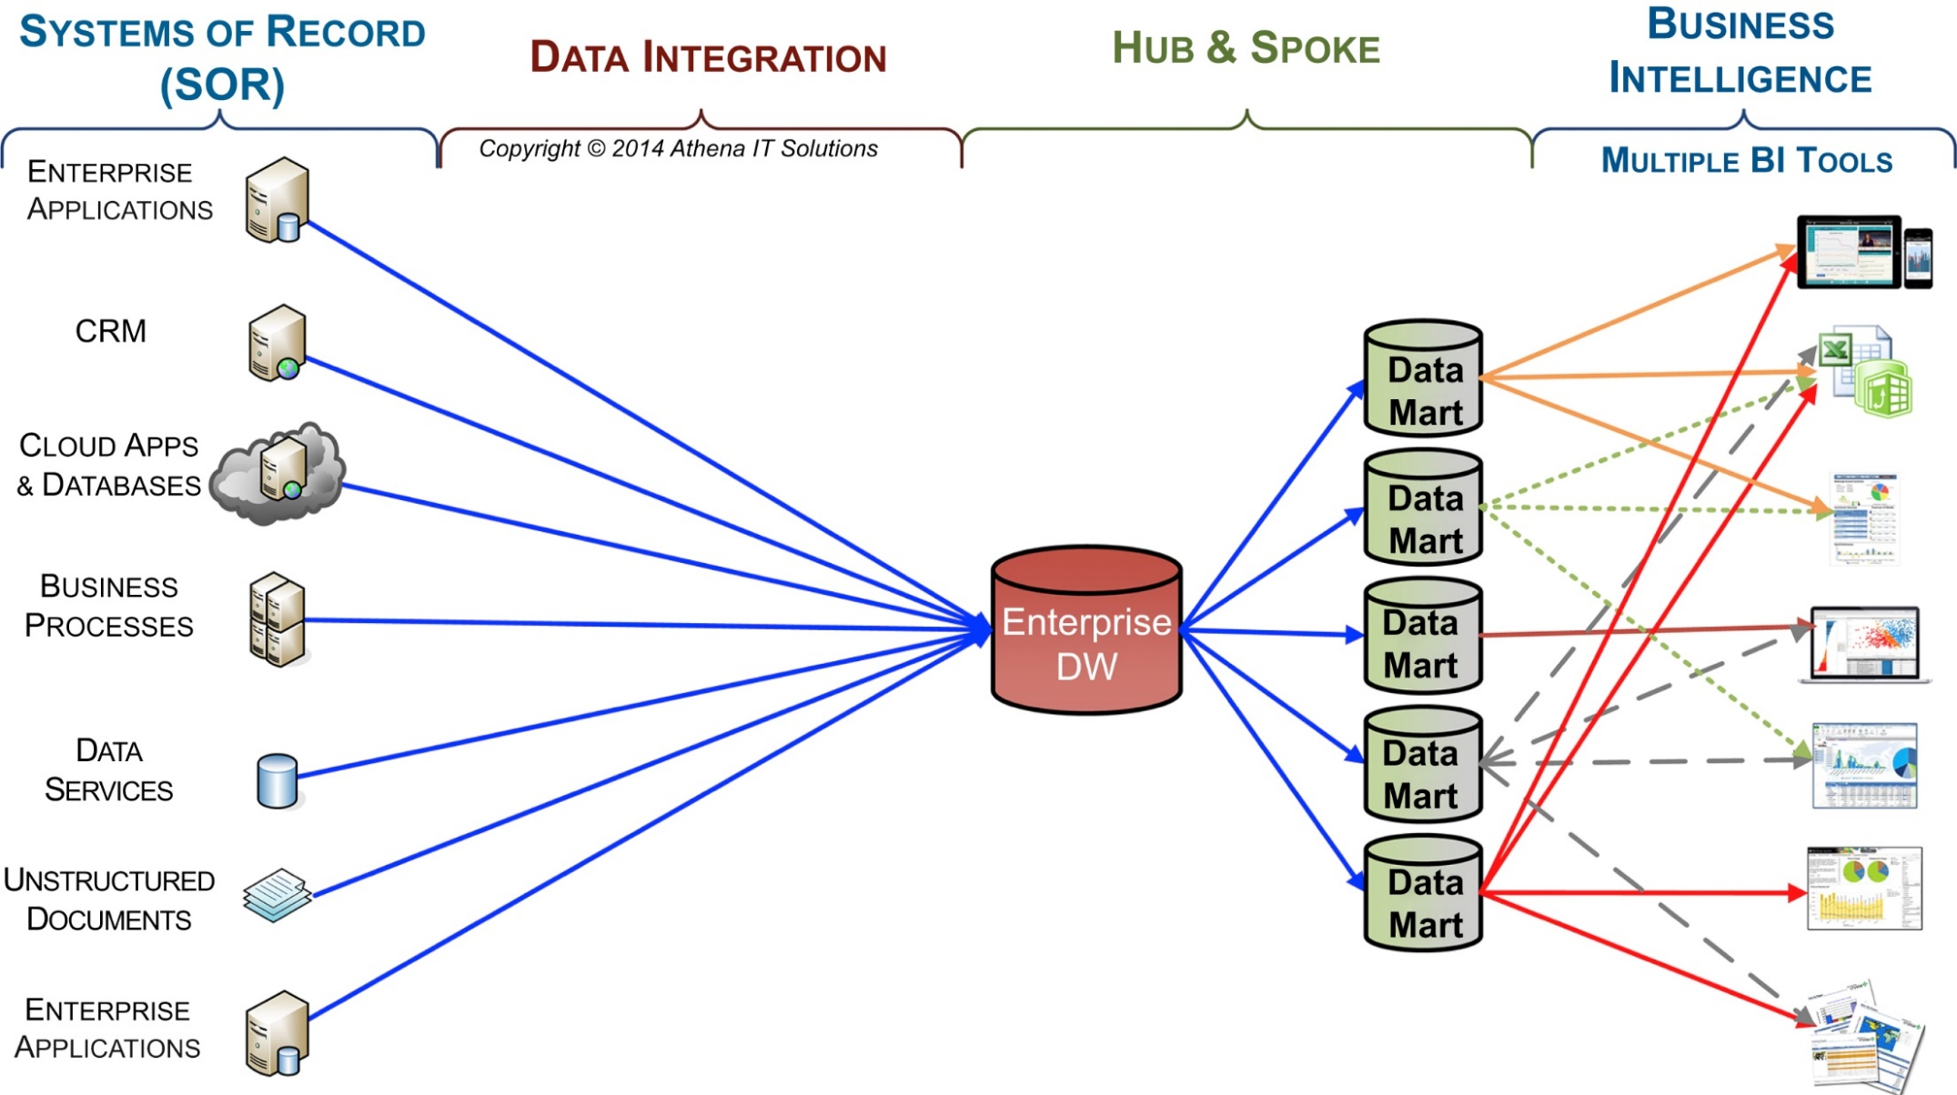
Hub & Spoke with multiple BI tools
f06-08

Slide 43
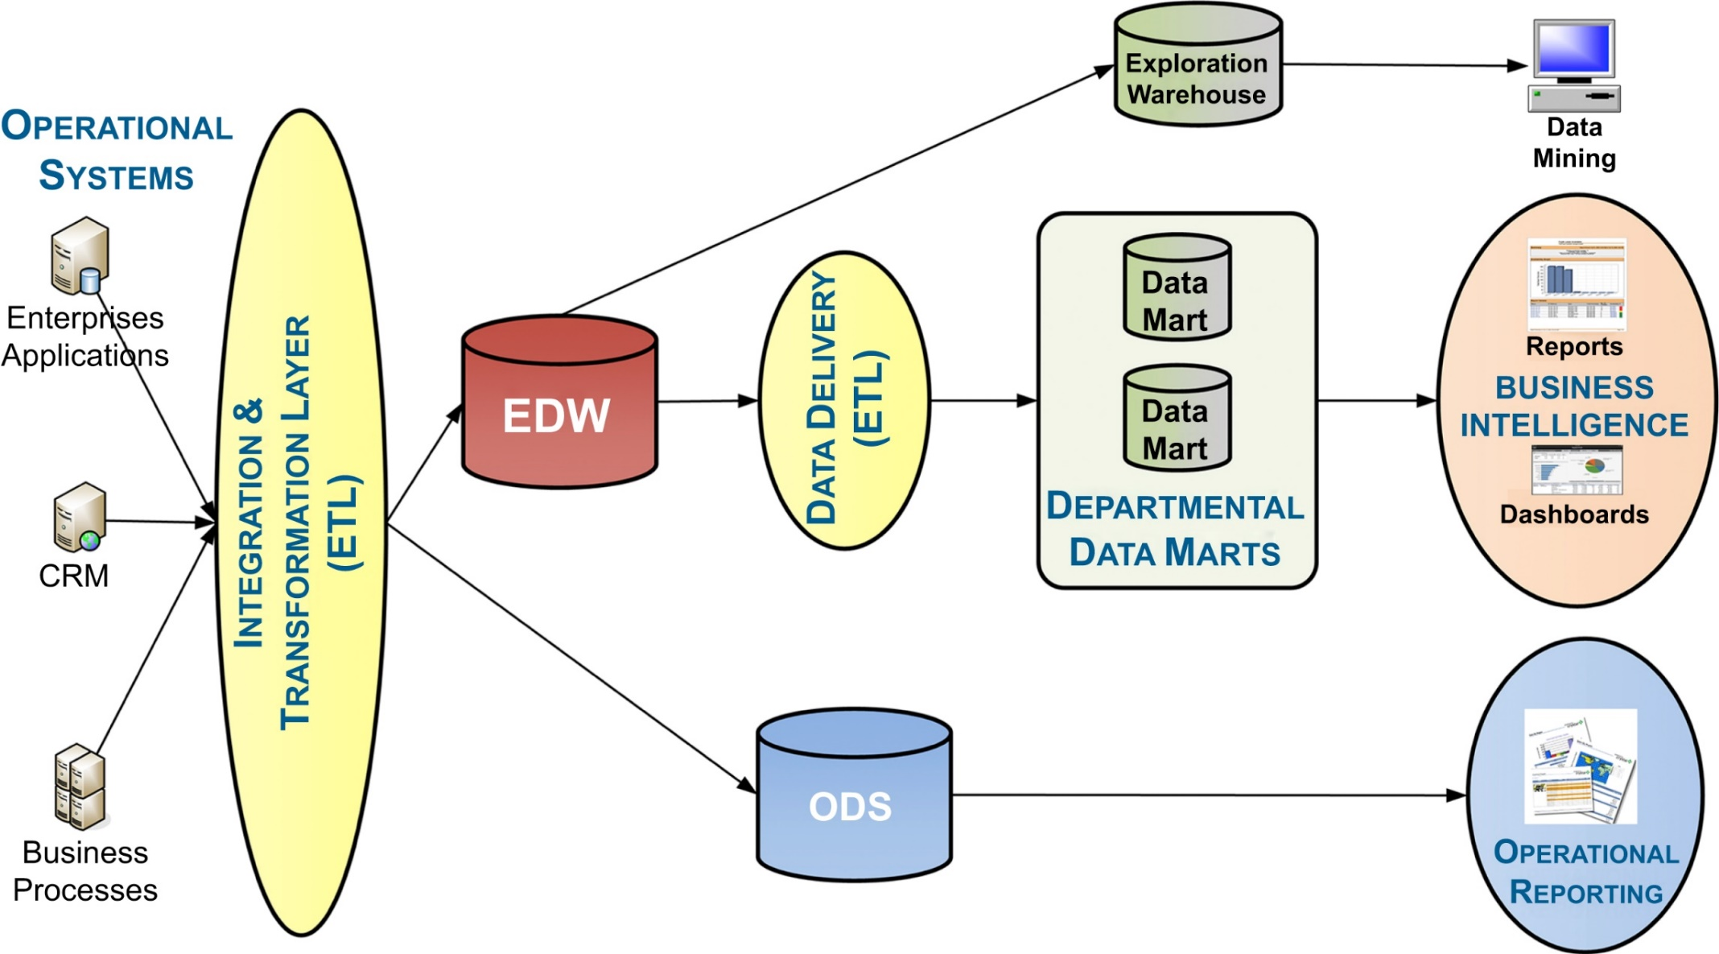
Inmon’s CIF architecture
f06-09

Slide 44
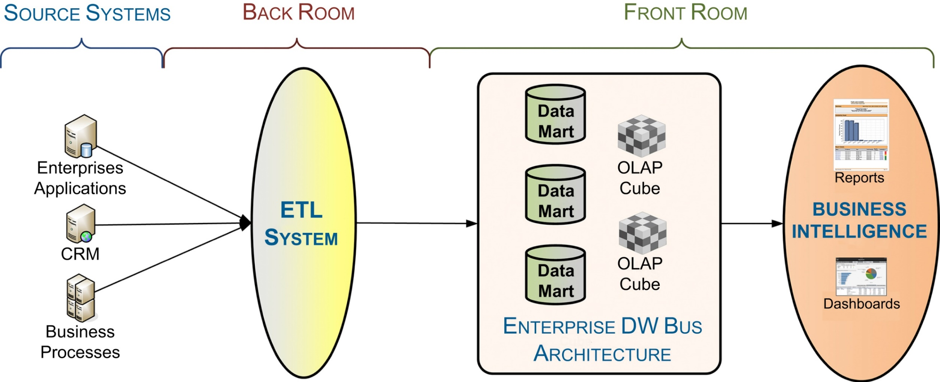
Kimball’s enterprise data bus architecture
f06-10

Slide 45
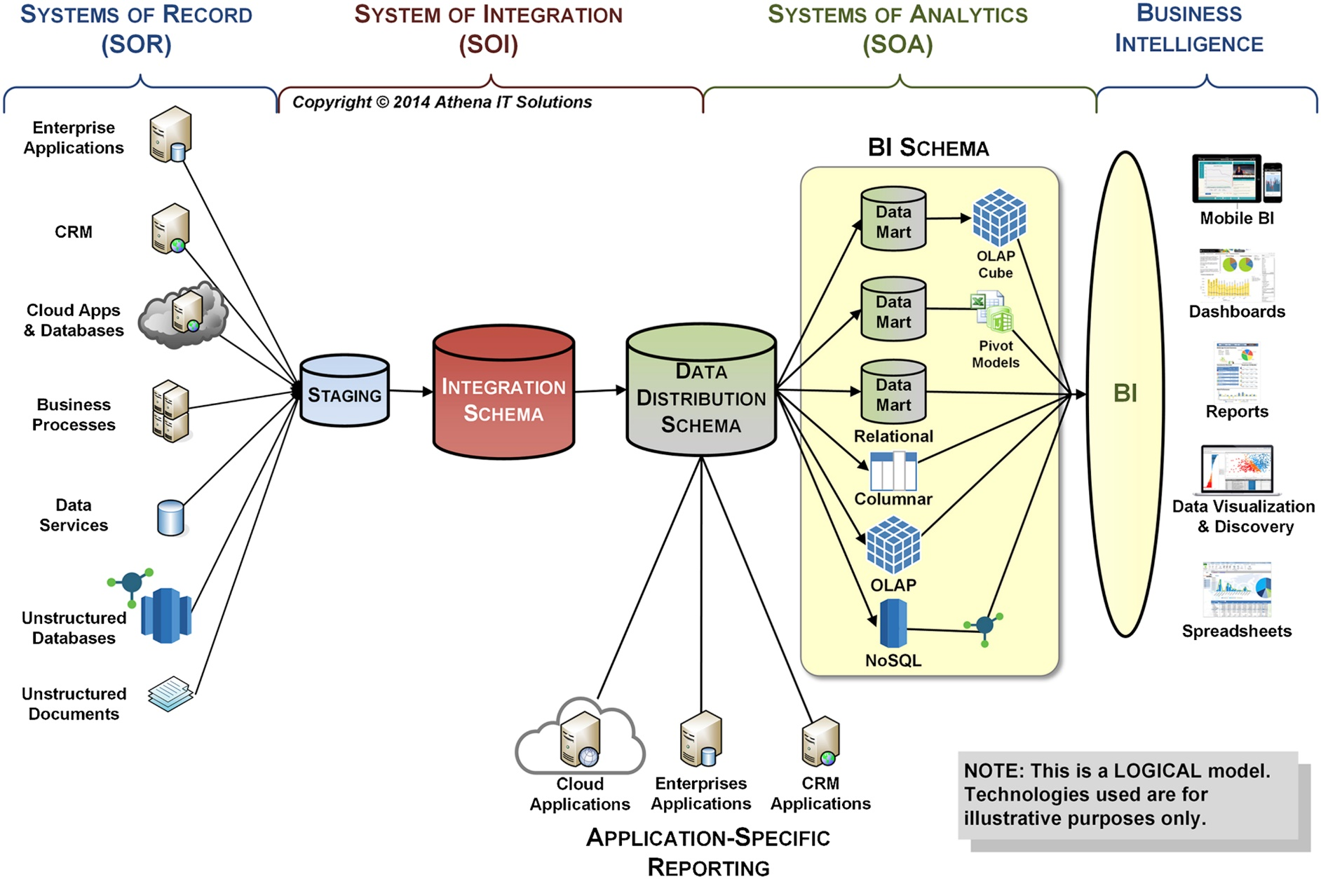
Analytical data architecture (ADA)
f06-11

Slide 46
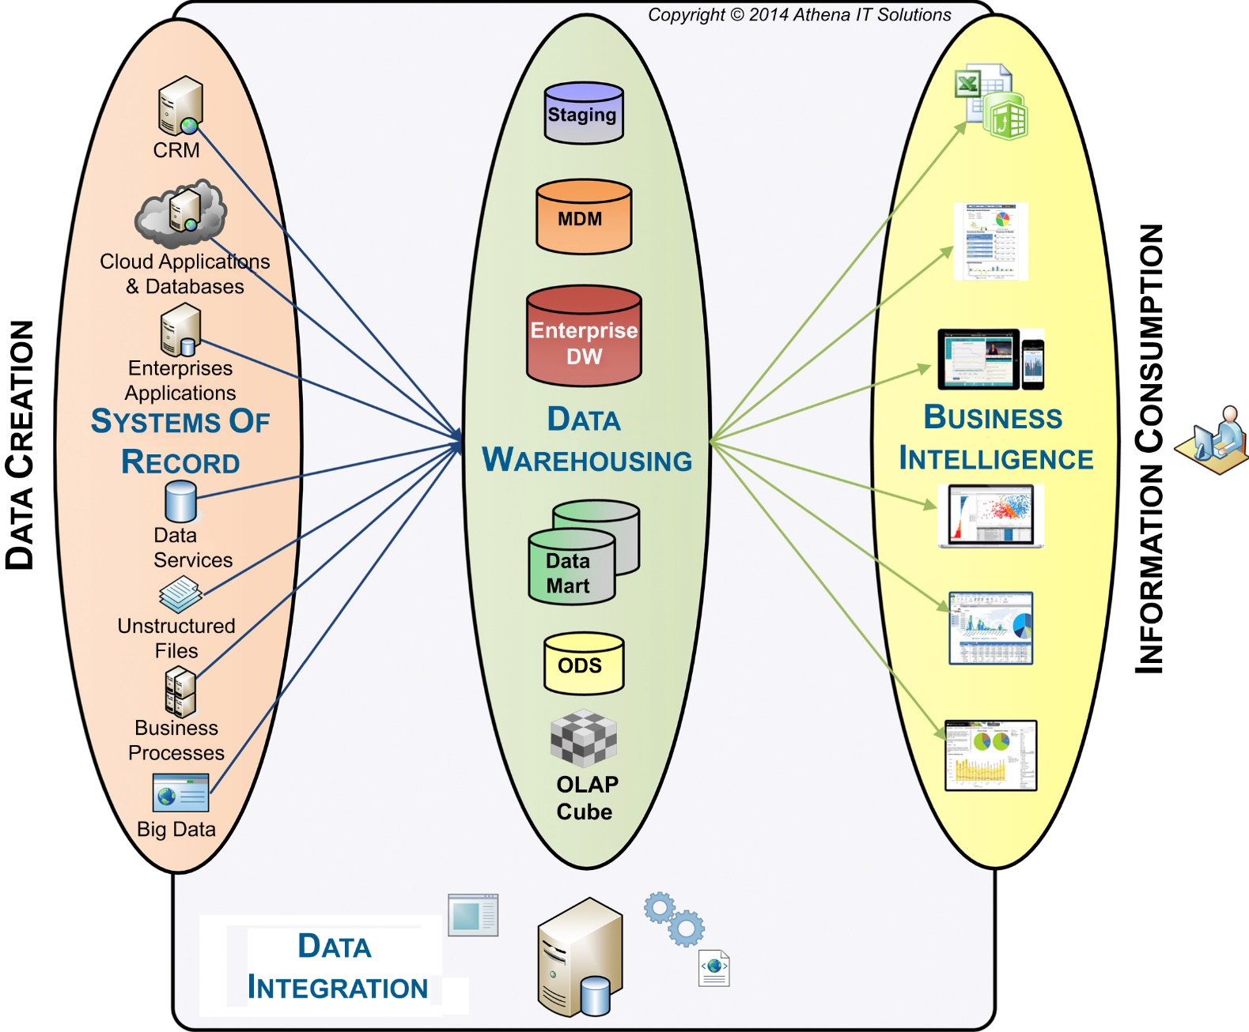
Data integration workflow
f06-12

Slide 47
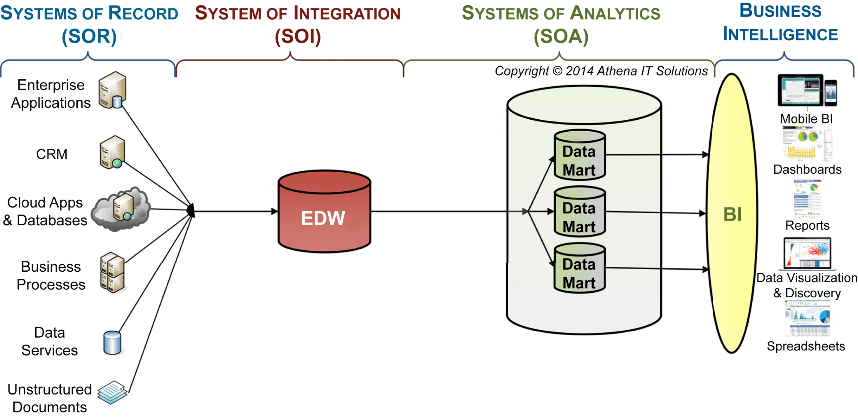
DI workflow – hub & spoke
f06-13

Slide 48
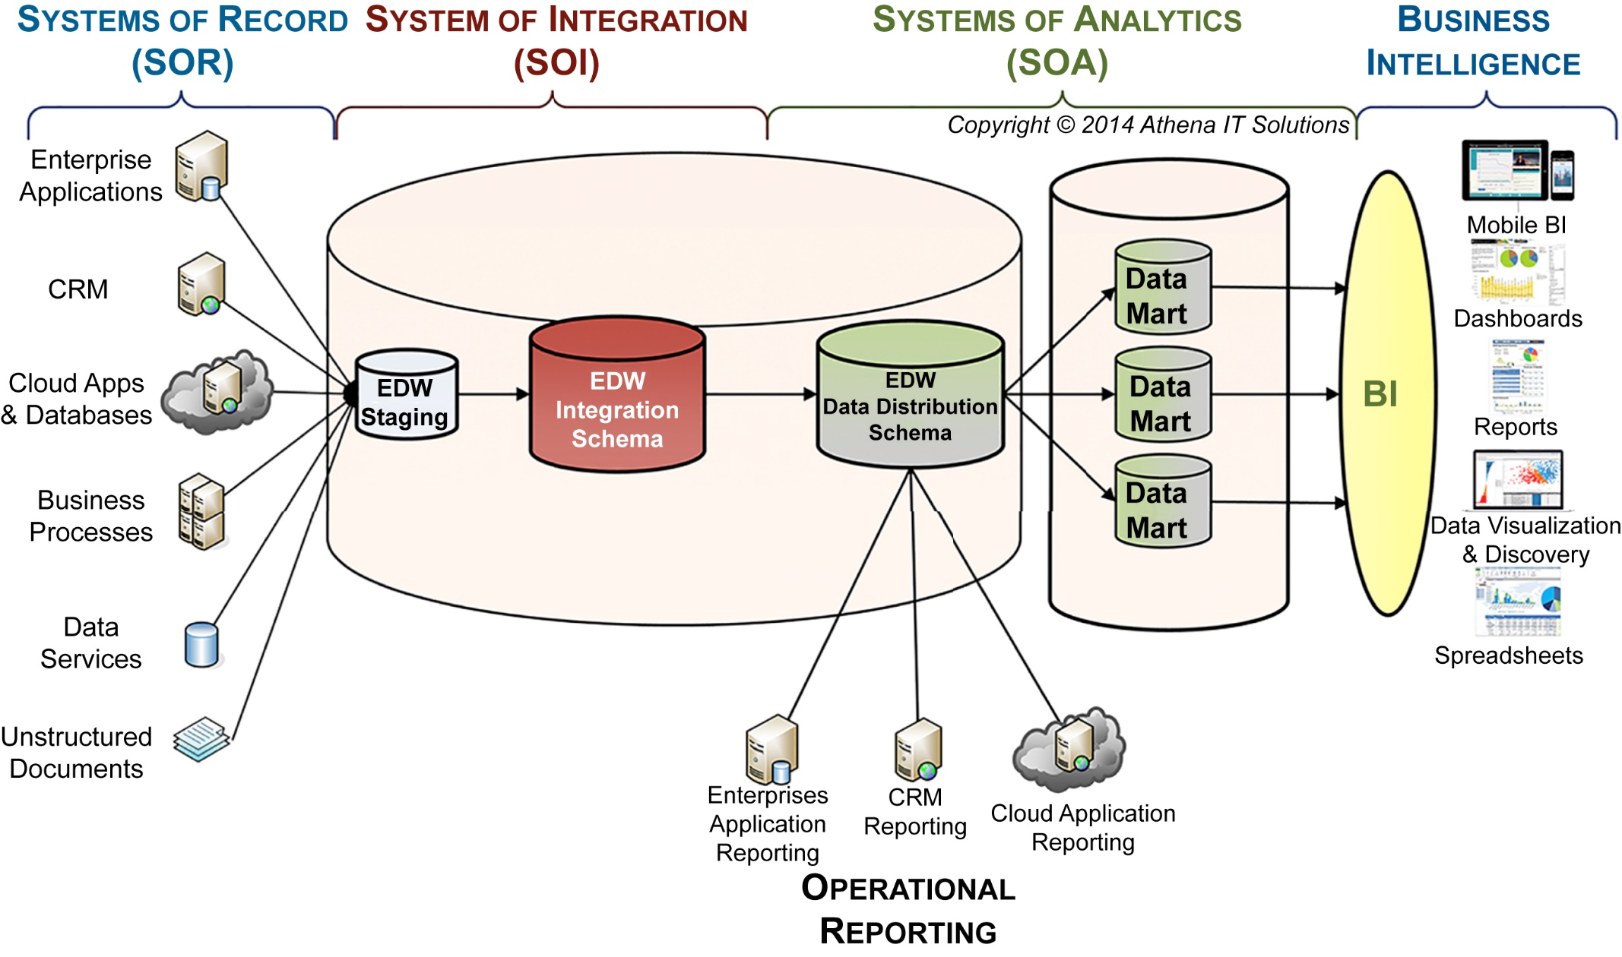
DI workflow – system of data integration data stores
f06-14

Slide 49
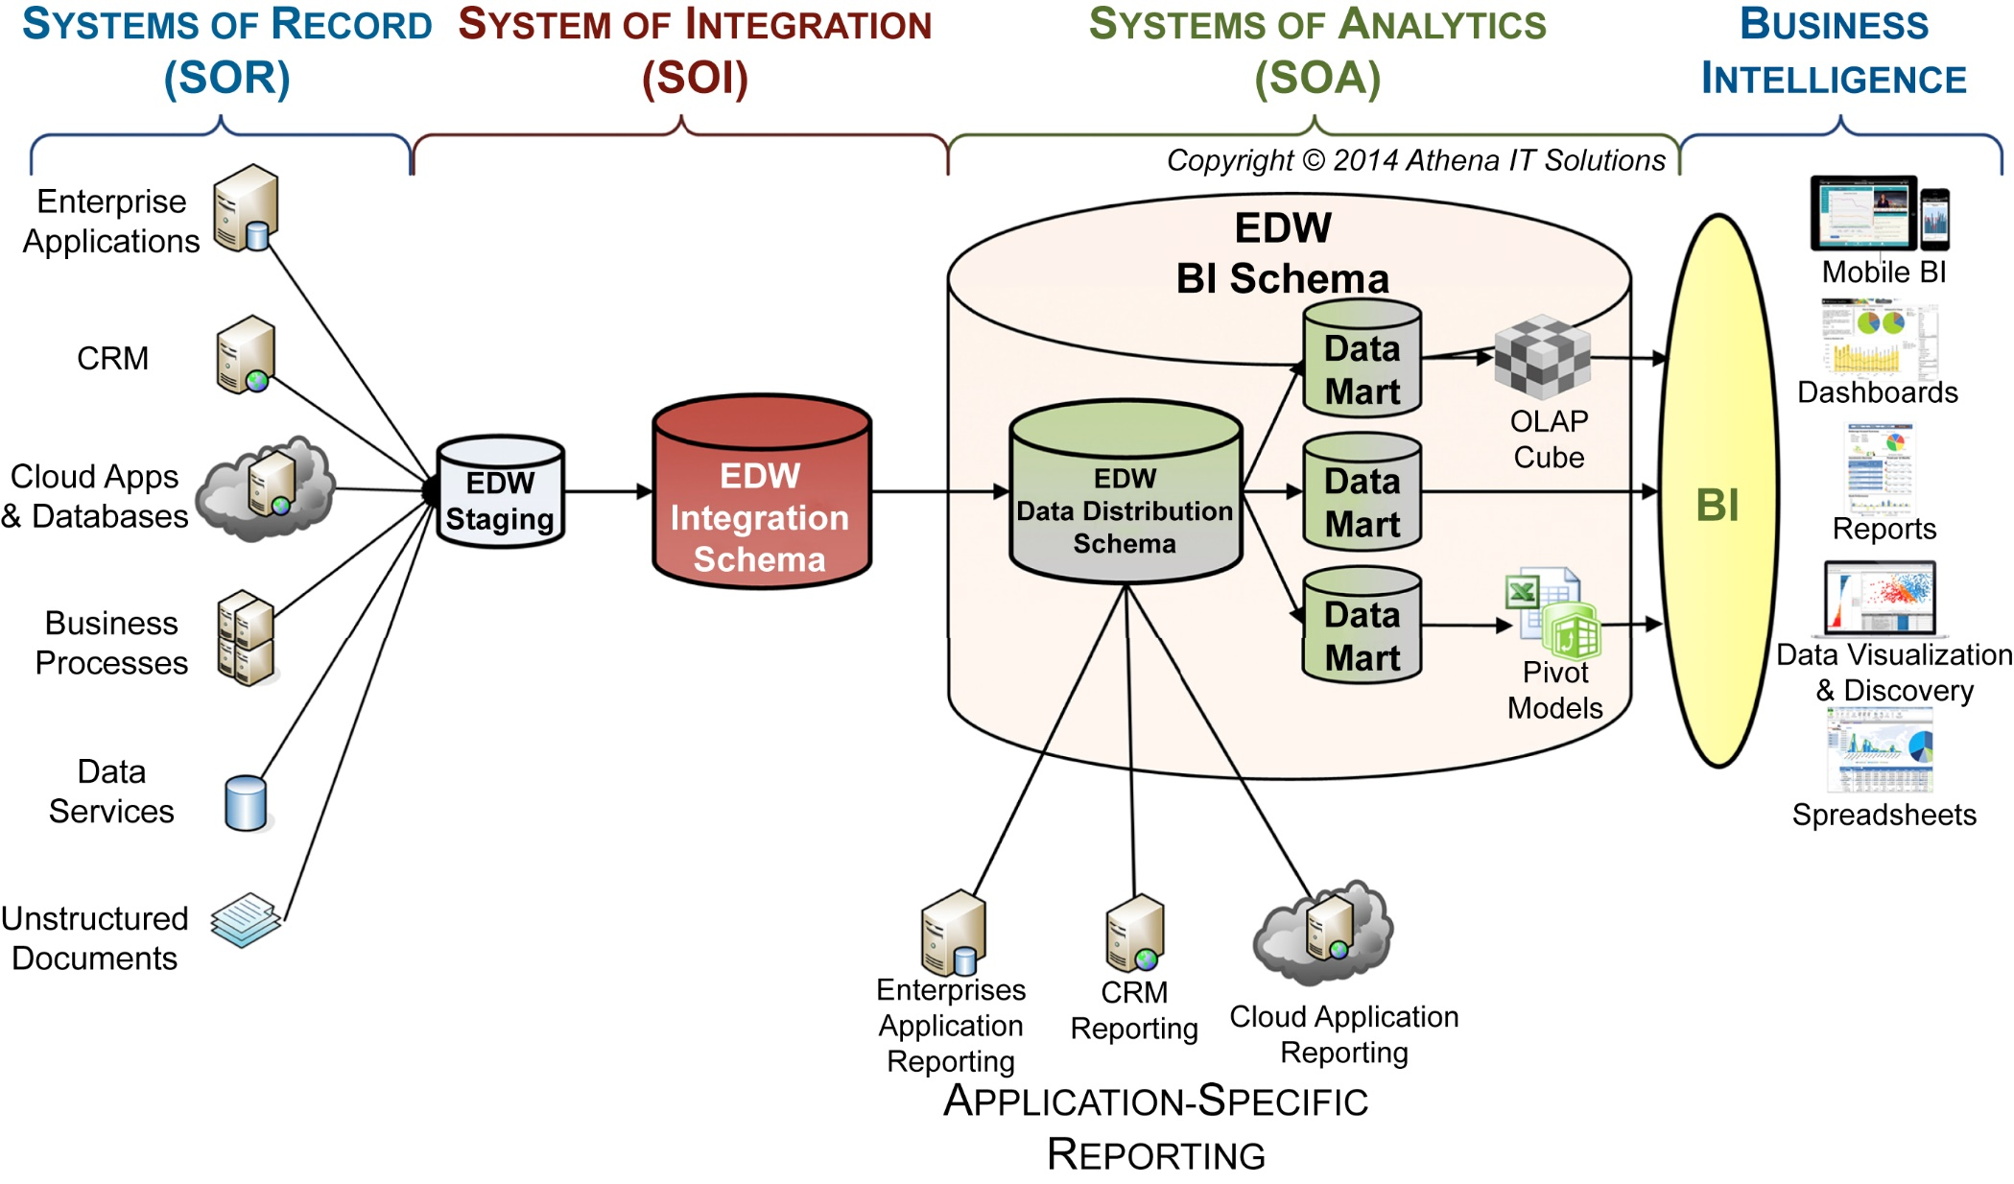
DI workflow – SOI and SOA
f06-15

Slide 50
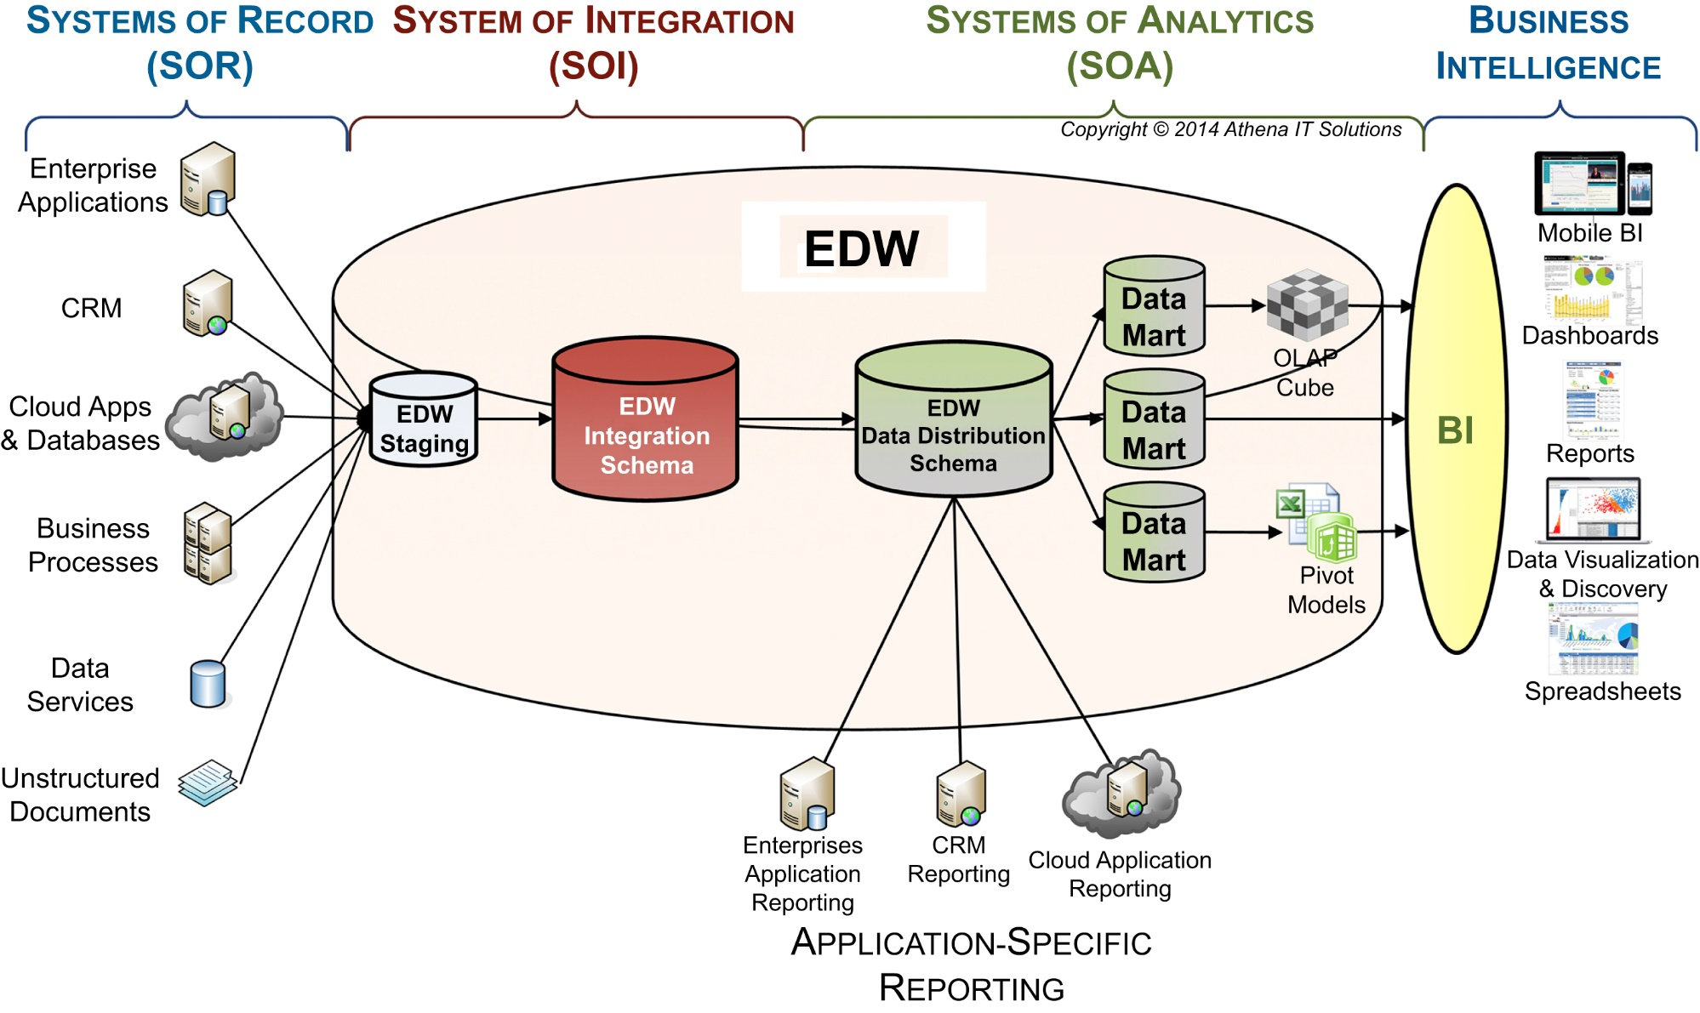
DI workflow – it’s different this time
f06-16

Slide 51
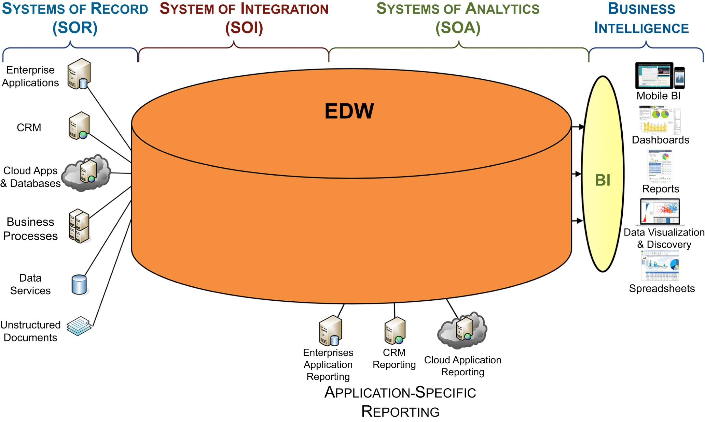
DI workflow – back to the future
f06-17

Slide 52
Chapter 7 Technology & Product Architectures

Slide 53
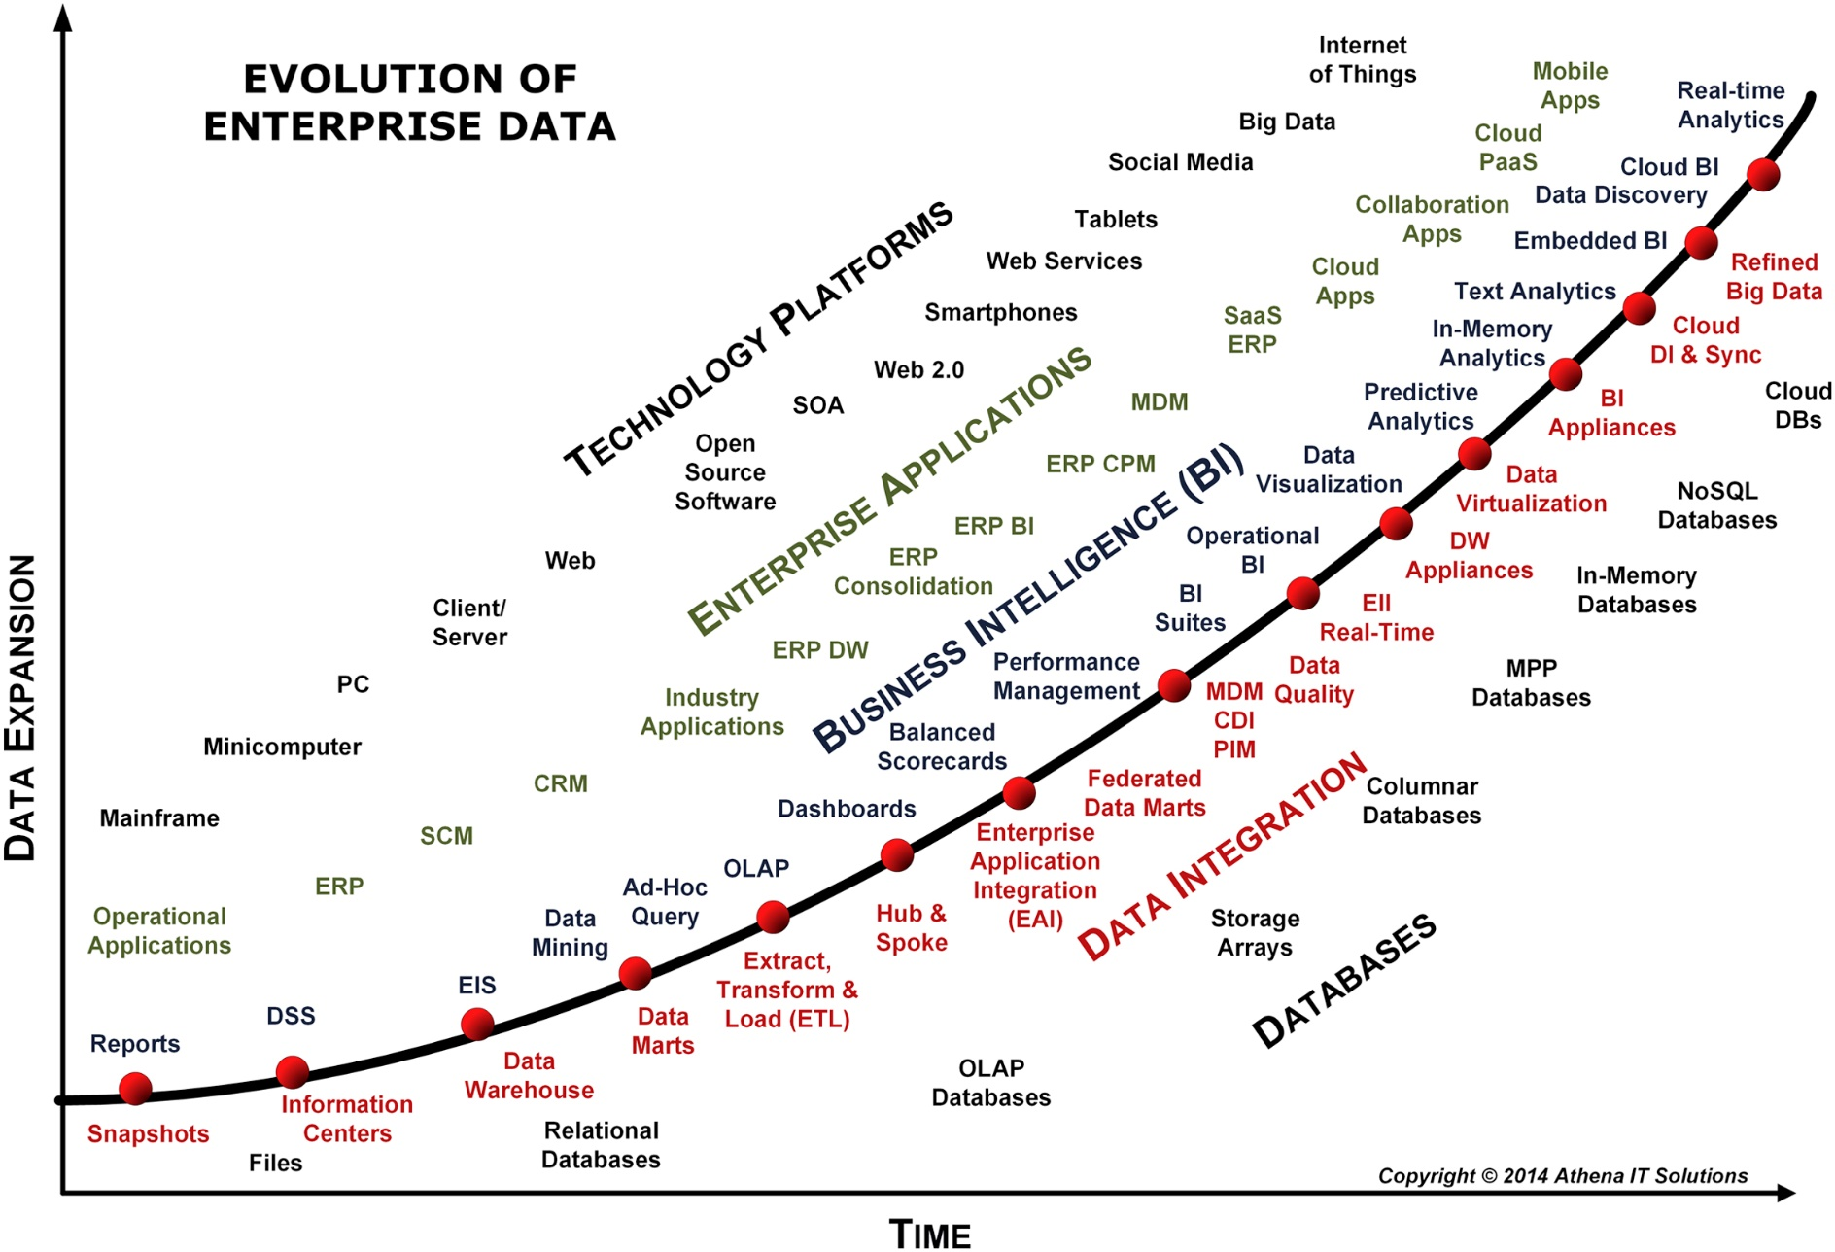
Evolution of enterprise data
f07-01

Slide 54
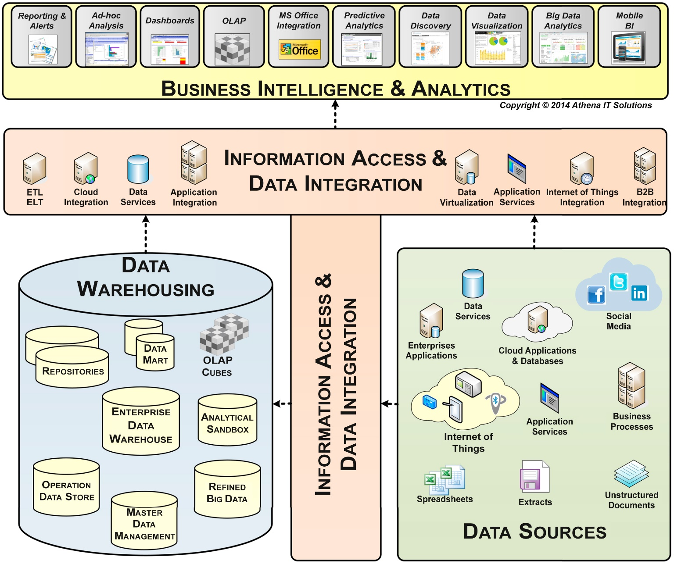
Technology architecture
f07-02

Slide 55
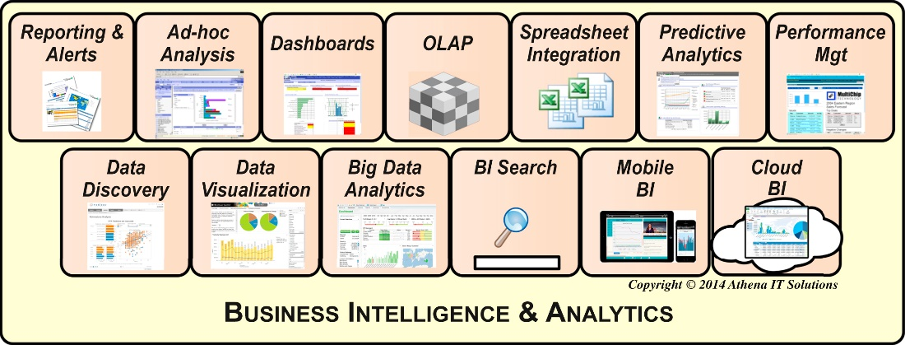
BI analytical styles
f07-03

Slide 56
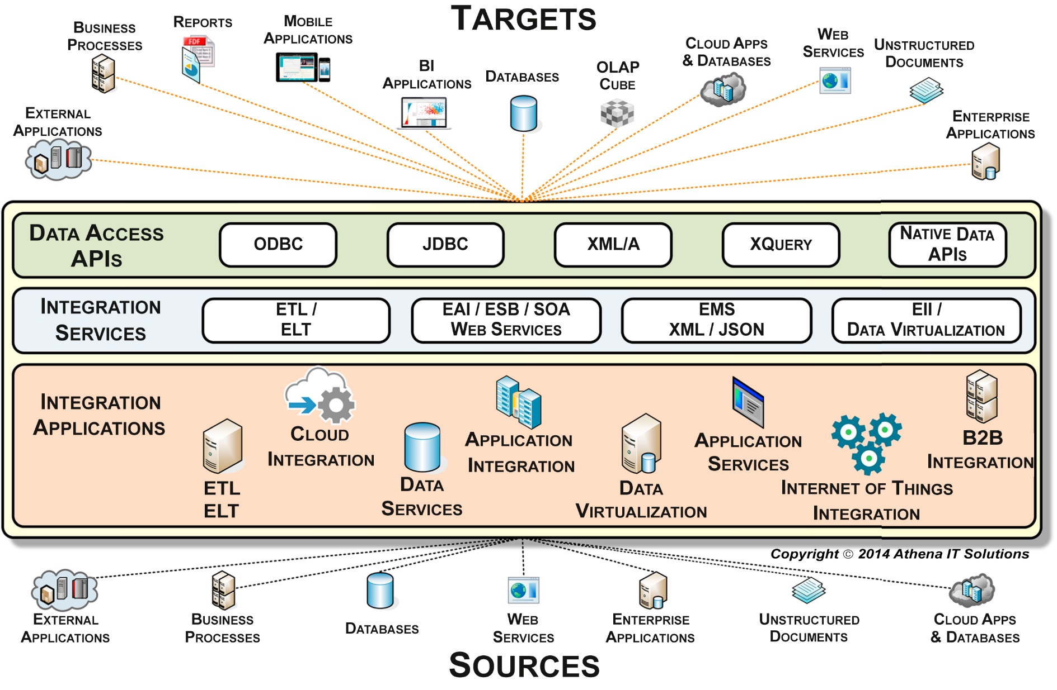
BI’s information access & data integration layer
f07-04

Slide 57
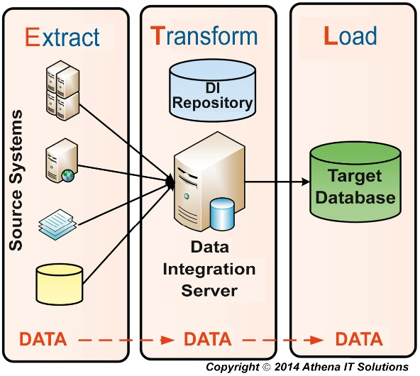
ETL architecture
f07-05

Slide 58
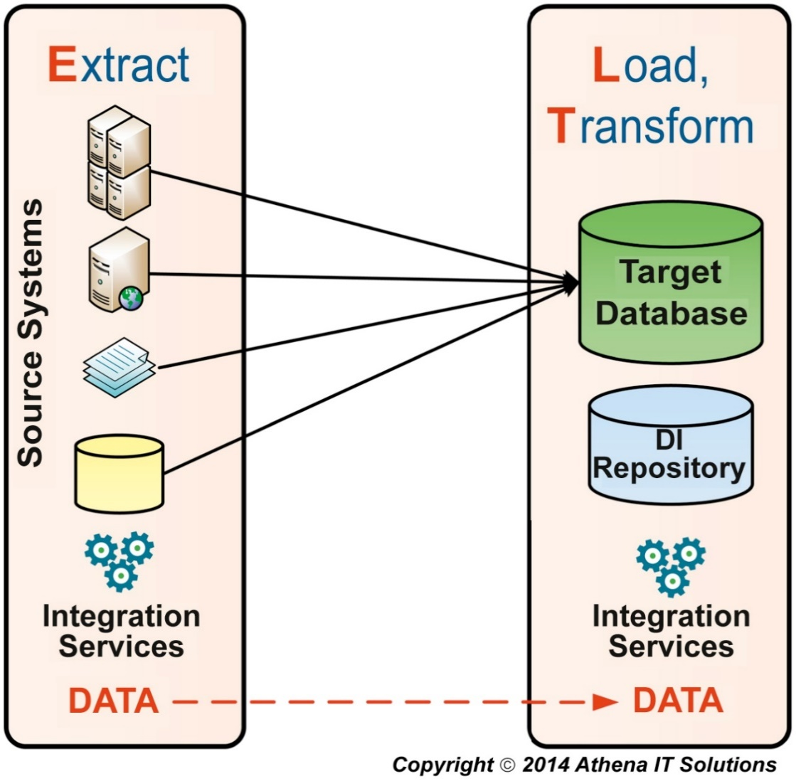
ELT architecture
f07-06

Slide 59
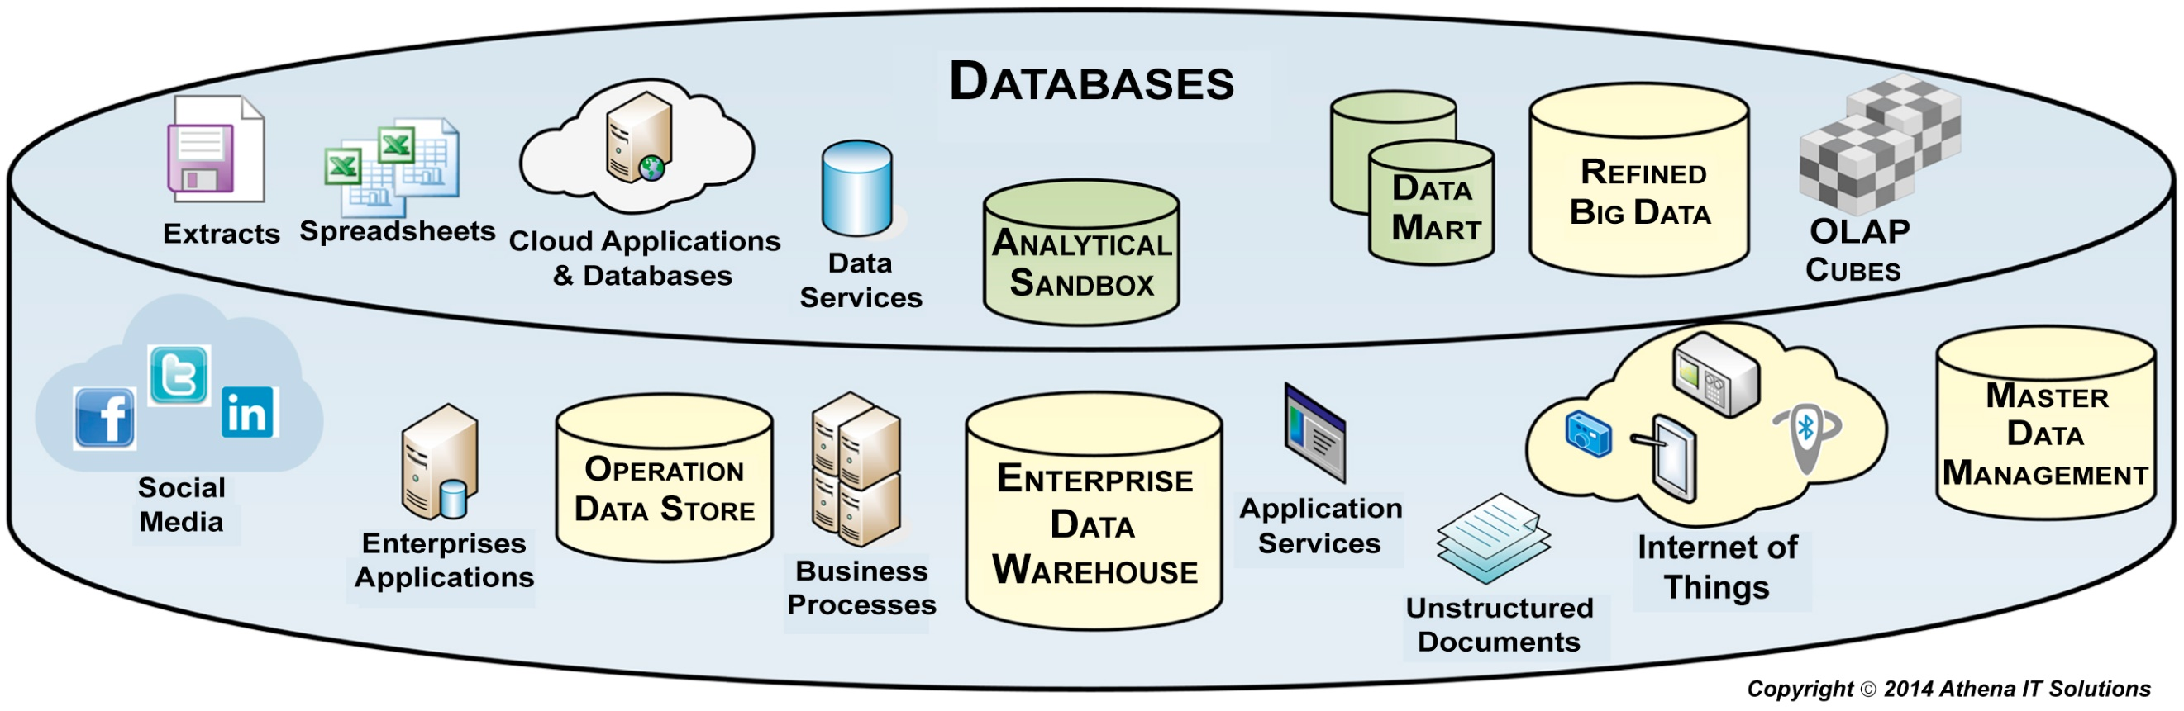
Technology architecture - databases
f07-07

Slide 60
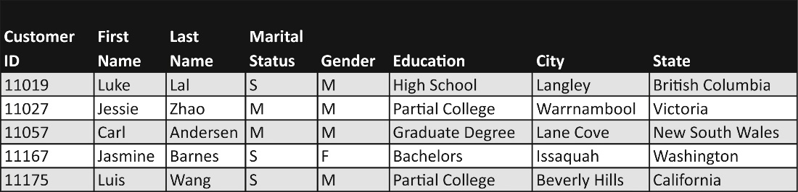
Customer data on a relational table
f07-08

Slide 61

Customer data stored in columnar tables
f07-09

Slide 62
Chapter 8 Foundational Data Modeling

Slide 63

Three levels of data models
f08-01

Slide 64

Data modeling workflow
f08-02

Slide 65

Entity vs. dimensional at a glance
f08-03

Slide 66

ER modeling building blocks
f08-04

Slide 67

Entity and attribute types
f08-05

Slide 68

Identifying relationships
f08-06

Slide 69

Non-identifying mandatory relationships
f08-07

Slide 70

Non-identifying optional relationship
f08-08

Slide 71

Many-to-many relationship
f08-09

Slide 72

Recursive relationship
f08-10

Slide 73

ER model example
f08-11

Slide 74

Key types
f08-12

Slide 75

Referential integrity
f08-13

Slide 76

1NF example
f08-14

Slide 77

1NF example (continued)
f08-15

Slide 78

2NF Example
f08-16

Slide 79

3NF Example
f08-17

Slide 80

ER Model Recap
f08-18

Slide 81
Chapter 9 Dimensional Modeling

Slide 82

Dimensional modeling overview
f09-01

Slide 83

Fact table - keys
f09-02

Slide 84

Fact tables – primary key with degenerative dimensions
f09-03

Slide 85

Fact table – primary key is a surrogate key
f09-04

Slide 86

Fact table - granularity
f09-05

Slide 87

Dimension – basic example
f09-06

Slide 88

Dimensional hierarchy
f09-07

Slide 89

Dimension keys
f09-08

Slide 90

Surrogate and natural keys
f09-09

Slide 91

Star schema
f09-10

Slide 92

Snowflake schema
f09-11

Slide 93

Multidimensional schema
f09-12

Slide 94

Multifact star models
f09-13

Slide 95

ER and dimensional models
f09-14

Slide 96

ER versus dimensional example
f09-15

Slide 97

Mapping to a business report
f09-16

Slide 98

Mapping to an OLAP analysis
f09-17

Slide 99

Date dimension
f09-18

Slide 100

Time as a fact
f09-19

Slide 101

Time as a dimension
f09-20

Slide 102

Time dimension – hour grain
f09-21

Slide 103

Time dimension – minute grain
f09-22

Slide 104

Time dimension with time bands
f09-23

Slide 105

Time zones
f09-24

Slide 106

Role-playing dimension approaches
f09-25

Slide 107

Degenerative dimension example
f09-26

Slide 108

Event table example
f09-27

Slide 109

Consolidated facts example
f09-28

Slide 110

Dimensional modeling recap
f09-29

Slide 111
Chapter 10 Business Intelligence Dimensional Modeling

Slide 112

Hierarchies
f10-01

Slide 113

Date dimension
f10-02

Slide 114

Standard and fiscal calendar hierarchies
f10-03

Slide 115

Ragged hierarchies
f10-04

Slide 116

Unbalanced hierarchies
f10-05

Slide 117

Employee recursive example
f10-06

Slide 118

Bridge table example
f10-07

Slide 119

Bridge table navigation
f10-08

Slide 120

Dimension outriggers
f10-09

Slide 121

Employee dimension – SCD type 1
f10-10

Slide 122

SCD type 1 schema template
f10-11

Slide 123

Fact table links to SCD type 1 dimension
f10-12

Slide 124

SOR dimension
f10-13

Slide 125

Create new row
f10-14

Slide 126

SCD type 2 template
f10-15

Slide 127

SCD type 2 schema template example
f10-16

Slide 128

Fact table links to SCD type 2 dimension
f10-17

Slide 129

Employee dimension – SCD type 3
f10-18

Slide 130

SCD type 3 template
f10-19

Slide 131

Fact table links to SCD type 3 dimension
f10-20

Slide 132

Customer dimension with both slowly and rapidly changing attributes
f10-21

Slide 133

Customer dimension example split into primary and mini-dimensions
f10-22

Slide 134

Customer dimension example with multiple mini-dimensions
f10-23

Slide 135

Customer dimension example with value-banded mini-dimensions
f10-24

Slide 136

Mini-dimension as outrigger
f10-25

Slide 137

Customer example type 5 with second mini-dimension
f10-26

Slide 138

Customer dimension example with hybrid mini-dimensions
f10-27

Slide 139

Employee example SCD type 6
f10-28

Slide 140

SCD type 6 schema
f10-29

Slide 141

SCD type 7 schema
f10-30

Slide 142

Causal dimension examples
f10-31

Slide 143

Bridge table approach
f10-32

Slide 144

Junk dimension example
f10-33

Slide 145

Value band reporting
f10-34

Slide 146

Value band reporting approaches
f10-35

Slide 147

Hot swappable dimension example
f10-36

Slide 148

Alternate dimension groups
f10-37

Slide 149
Chapter 11 Data Integration Design and Development

Slide 150

Data Integration (DI) workflow
f11-01

Slide 151

DI workflow integration breakpoints
f11-02

Slide 152

Gathering data requirements
f11-03

Slide 153

The order of designing data models
f11-04

Slide 154

Conceptual data integration model – data sourcing
f11-05

Slide 155

Logical data integration modeling
f11-06

Slide 156

Data integration physical model
f11-07

Slide 157

System of record (SOR) dimension
f11-08

Slide 158

Natural key standard
f11-09

Slide 159

Audit column standard
f11-10

Slide 160

Slowly changing dimensions effective date standard
f11-11

Slide 161

Dimension table with rows indicating null values
f11-12

Slide 162
Chapter 12 Data Integration Processes

Slide 163

Extract, transform and load tools
f12-01

Slide 164

Hand-coded extract, transform and load
f12-02

Slide 165

Cost comparison: hand-coded vs. tool-based extract, transform and load (ETL)
f12-03

Slide 166

Extract, transform, load and manage
f12-04

Slide 167

Data integration suite - services
f12-05

Slide 168

Data integration suite – services breakdown
f12-06

Slide 169

Change data capture – two audit columns
f12-07

Slide 170

Change data capture – single audit column
f12-08

Slide 171

Source system analysis
f12-09

Slide 172

Data integration workflow
f12-10

Slide 173

Dimension table service
f12-11

Slide 174

Fact table service
f12-12

Slide 175

Aggregation service creates shrunken dimension
f12-13

Slide 176

Aggregation service creates aggregation fact table
f12-14

Slide 177

Data integration jobs workflow
f12-15

Slide 178

Data integration table – job audit columns
f12-16

Slide 179
Chapter 13 Business Intelligence Applications

Slide 180

Dashboard example 1
f13-01

Slide 181

Dashboard example 2
f13-02

Slide 182

BI data sources
f13-03

Slide 183

Comparison analysis – bar chart
f13-04

Slide 184

Trend analysis with line graph
f13-05

Slide 185

Trend analysis – area chart
f13-06

Slide 186

Trend analysis – bar chart
f13-07

Slide 187

Contribution analysis – heat map
f13-08

Slide 188

Correlation analysis – scatter plot
f13-09

Slide 189

Geography mapping
f13-10

Slide 190

Distribution analysis – box plot
f13-11

Slide 191
Chapter 14 BI Design and Development

Slide 192

BI visual design methods
f14-01

Slide 193

Whiteboard sketch
f14-02

Slide 194

BI application wireframe
f14-03

Slide 195

BI storyboard example
f14-04

Slide 196

BI mockup example
f14-05

Slide 197

BI prototyping
f14-06

Slide 198

BI application development lifecycle
f14-07

Slide 199

BI application testing
f14-08

Slide 200
Chapter 15 Advanced Analytics

Slide 201

Predictive modeling project methodology
f15-01

Slide 202

Example of advanced analytical architecture
f15-02

Slide 203

Analytical sandbox
f15-03

Slide 204

Analytical hub
f15-04

Slide 205

Analytical hub - architecture
f15-05

Slide 206

Analytical sandbox - architecture
f15-06

Slide 207
Chapter 16 Data Shadow Systems

Slide 208

Data shadow systems are BI silos
f16-01

Slide 209

Data workflow
f16-02

Slide 210

Data shadow system example
f16-03

Slide 211
Chapter 17 People, Process and Politics

Slide 212

Four P’s of BI
f17-01

Slide 213

BI project team
f17-02

Slide 214

Project development team – core functions
f17-03

Slide 215

Data governance and centers of excellence (COEs)
f17-04

Slide 216
Chapter 18 Project Management

Slide 217

Enterprise business strategy and business initiatives
f18-01

Slide 218

Business strategy and plans drive BI program
f18-02

Slide 219

BI program composed of multiple BI projects
f18-03

Slide 220

BI programs need business involvement
f18-04

Slide 221

BI program release planning template
f18-05

Slide 222

BI project - tradeoffs
f18-06

Slide 223

BI assessments: four subject areas
f18-07

Slide 224

BI assessment framework
f18-08

Slide 225

Three phases of BI assessment
f18-09

Slide 226

BI assessment: discovery tasks
f18-10

Slide 227

BI assessment: analysis tasks
f18-11

Slide 228

BI assessment: recommendations tasks
f18-12

Slide 229

Work breakdown structure – BI program
f18-13

Slide 230

Work breakdown structure – BI project by program phase
f18-14

Slide 231

Work breakdown structure – BI architecture
f18-15

Slide 232

BI project phases with four architectures
f18-16

Slide 233

Project phases
f18-17

Slide 234

BI project work breakdown structure with functional groupings
f18-18

Slide 235

BI project work breakdown structure: functional groups with key tasks
f18-19

Slide 236

BI functional group
f18-20

Slide 237

Data and database functional group
f18-21

Slide 238

Data integration functional group
f18-22

Slide 239

Infrastructure functional group
f18-23

Slide 240
Chapter 19 Centers of Excellence

Slide 241

BI COE interactions
f19-01

Slide 242

Three data management processes
f19-02

Slide 243

Data management organizational interconnections
f19-03

